Slide 1
welcome to church !

Slide 2
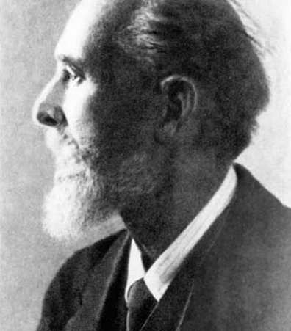
Peter Carl Faberge

Slide 3
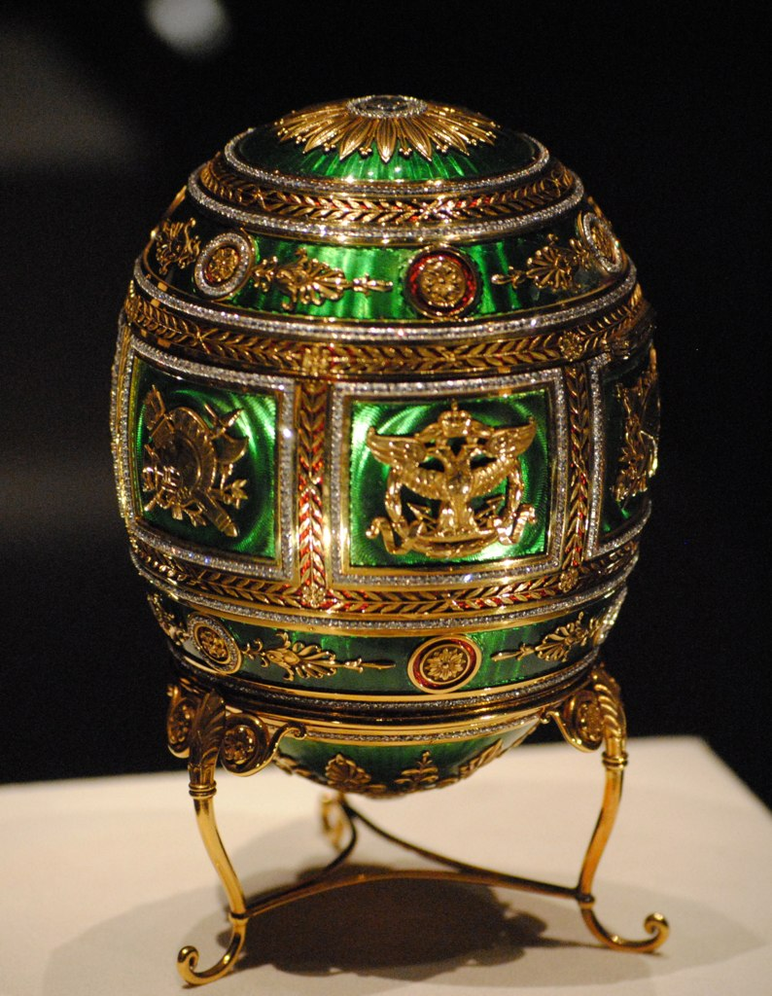

Slide 4
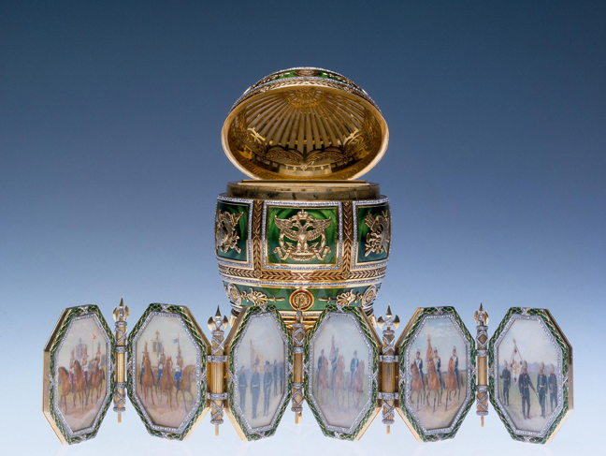

Slide 5
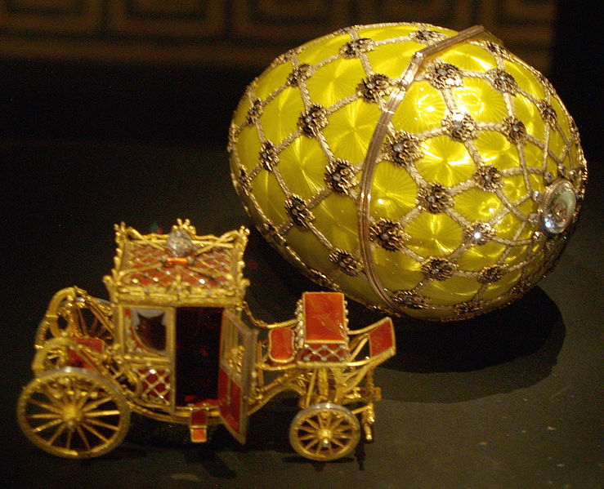

Slide 6
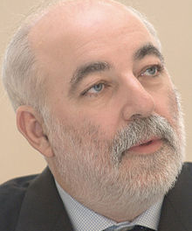

Slide 7
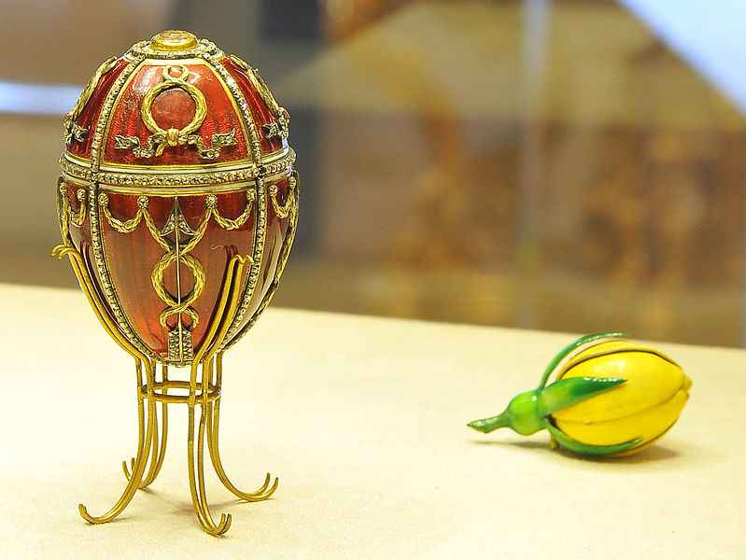

Slide 8
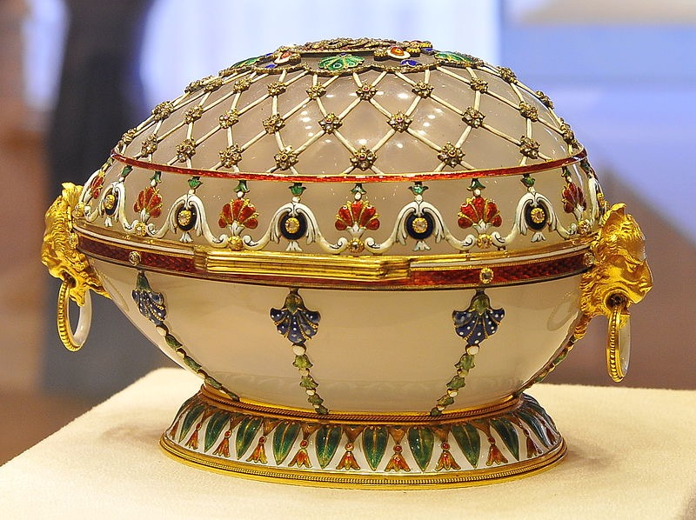

Slide 9
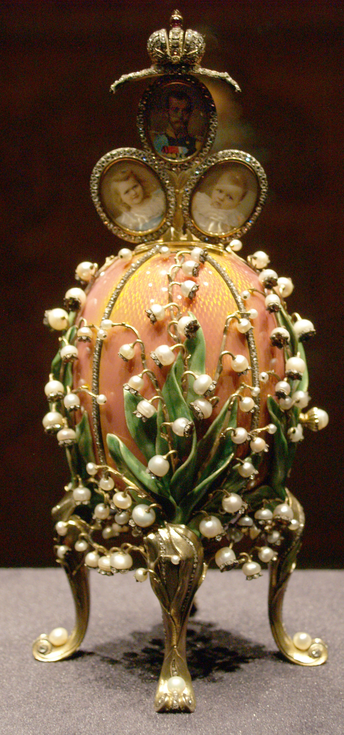

Slide 10
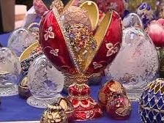

Slide 11
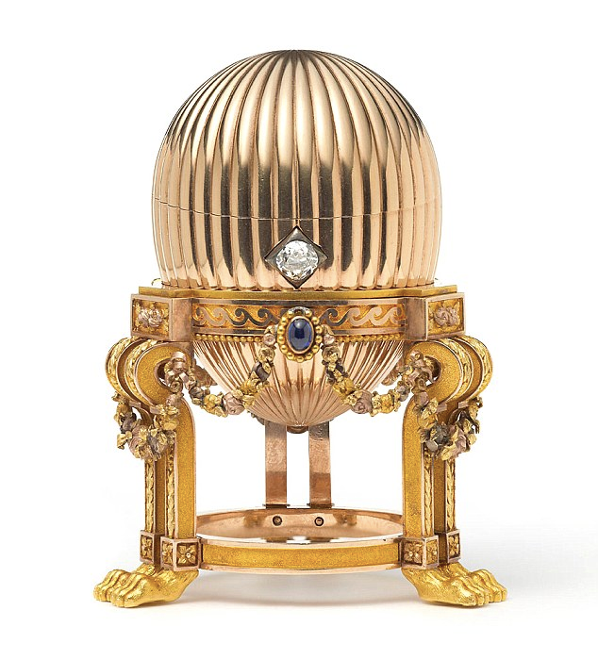
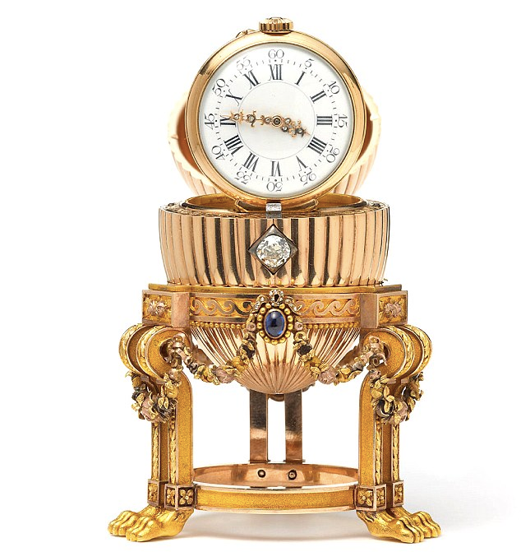

Slide 12
welcome to church !

Slide 13
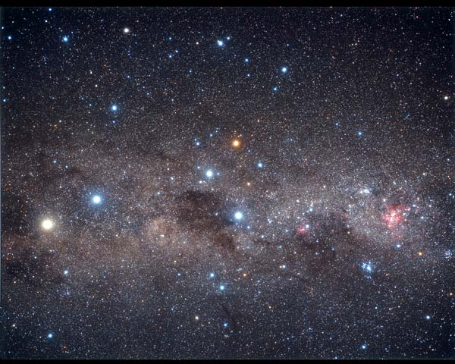

Slide 14
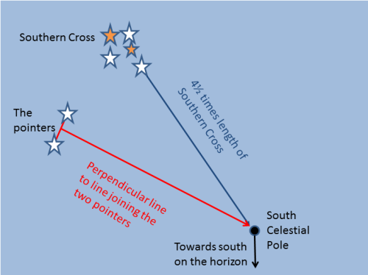

Slide 15
Something new

Slide 16
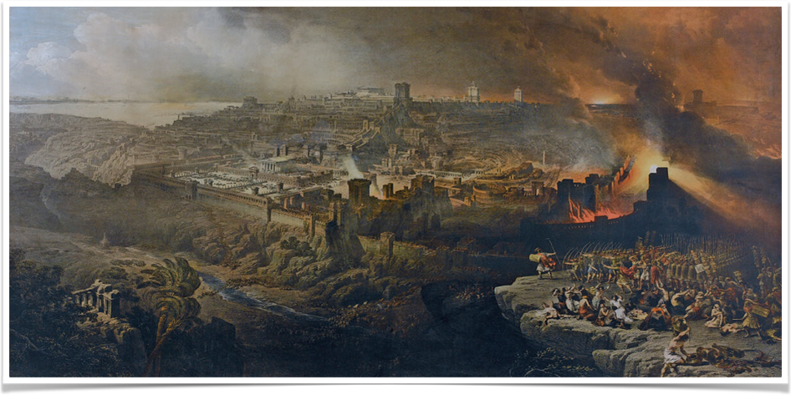
babylonian captivity

Slide 17
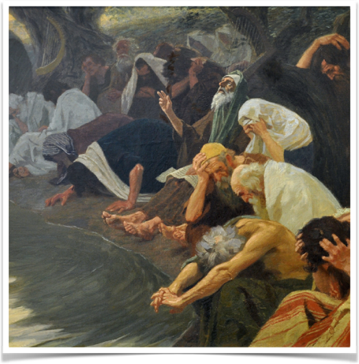
Psalm 137
5 If I forget you, Jerusalem, may my right hand forget its skill.
6 May my tongue cling to the roof of my mouth if I do not remember you
Gebhard Fugel : An den Wassern Babylons

Slide 18
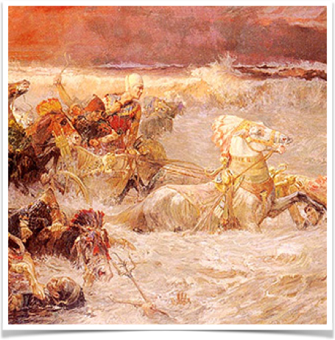
isaiah 43:14-17
16This is what the Lord says—
he who made a way through the sea,
a path through the mighty waters,
17 who drew out the chariots and horses,
the army and reinforcements together,
and they lay there, never to rise again,
extinguished, snuffed out like a wick:

Slide 19
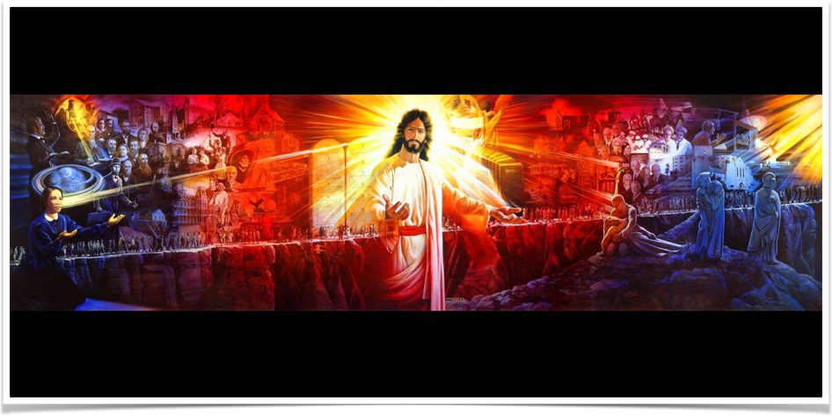
Christ of the narrow way
Elfred Lee

Slide 20
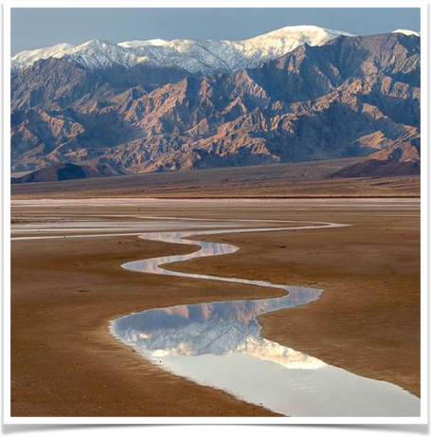
isaiah 43:18-19
18 “Forget the former things; do not dwell on the past.
19 See, I am doing a new thing! Now it springs up; do you not perceive it?
I am making a way in the wilderness and streams in the wasteland.

Slide 21
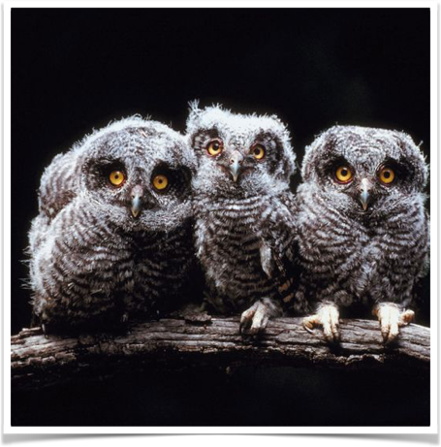
isaiah 43:20-21
20 The wild animals honour me, the jackals and the owls,
because I provide water in the wilderness and streams in the wasteland, to give drink to my people, my chosen,
21 the people I formed for myself that they may proclaim my praise.

Slide 22
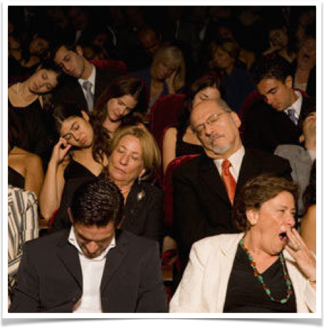
isaiah 43:22
22 “Yet you have not called on me, Jacob,
you have not wearied yourselves for me, Israel.

Slide 23
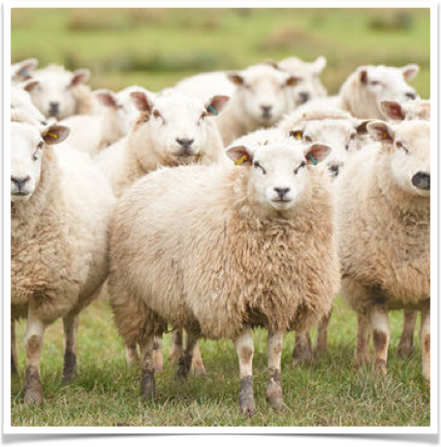
isaiah 43:23
23 You have not brought me sheep for burnt offerings,
nor honoured me with your sacrifices.
I have not burdened you with grain offerings
nor wearied you with demands for incense.

Slide 24
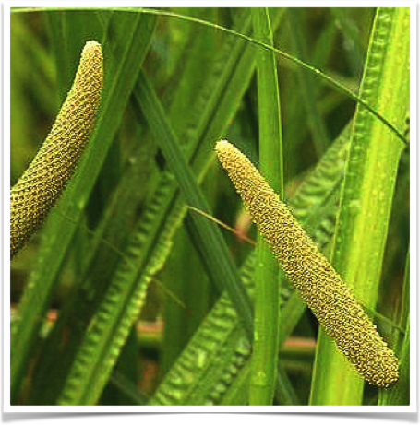
isaiah 43:24
24 You have not bought any fragrant calamus for me,
or lavished on me the fat of your sacrifices.
But you have burdened me with your sins
and wearied me with your offenses.

Slide 25
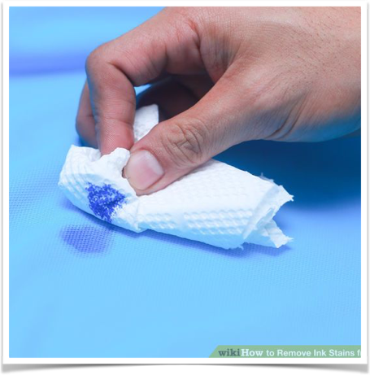
isaiah 43:25
25 “I, even I, am he who blots out
your transgressions, for my own sake,
and remembers your sins no more.

Slide 26
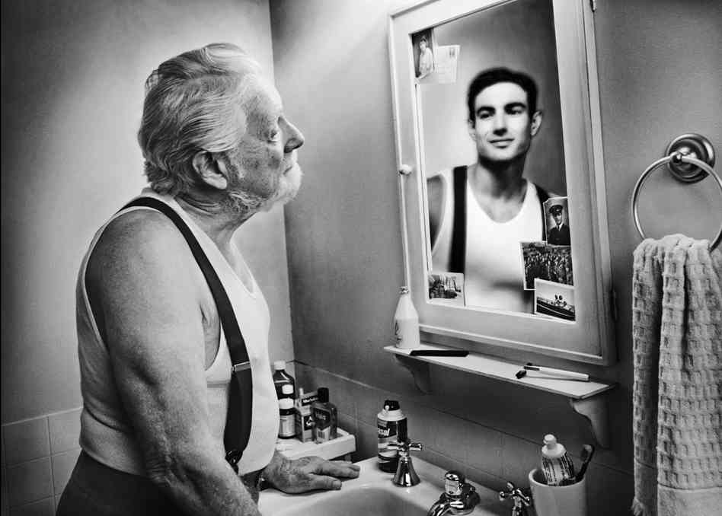

Slide 27
