Slide 1
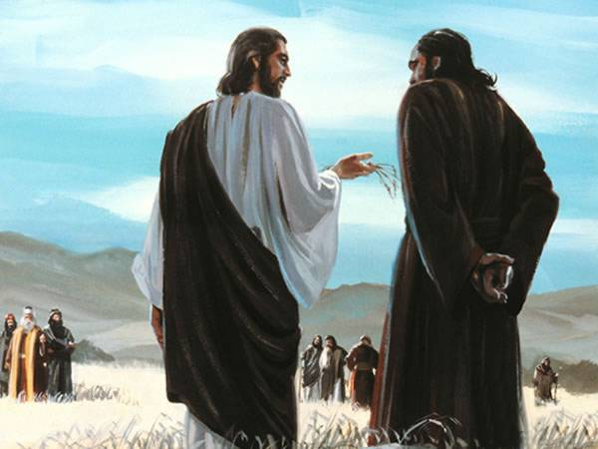
Notes:
How do we respond to things that Jesus tells us ?
Our response is important,
How we act on the information that Jesus provides determines how we live.
It also has eternal consequences.
<number>

Slide 2
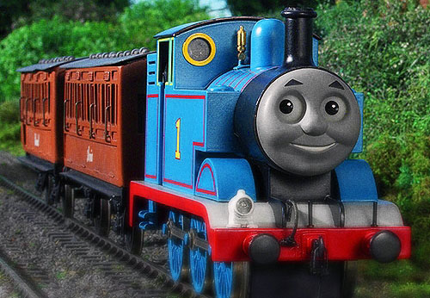
Notes:
Thomas the skeptic.
The one who casts doubt
Thomas hears that Jesus finally decides to return to Bethany.
Thomas in response mutter doubt and discouragment to the other Disciples.
But Jesus has another plan.
His plan is to fully reveal the glory of God.
His plan is to provide Hope
In John 11 Jesus that I am glad that I was not there. I allowed Lazerus to die because I have something to show you.
There is some information that you, Thomas need to know about Me.
On a later occasion in John 14:5 we say again Thomas casting doubt.
Jesus says in “In my house are many mansions, If it were not so I would have told you….I go to prepare a place for you…
But Thomas response was:
“Lord we do not know where You are going and how can we know the way ?
Jesus replies : I am the Way, the Truth and the LIFE (In other words the One who provides life)
<number>

Slide 3
Then Jesus said to them plainly,
“Lazarus is dead. And I am glad for your sakes that I was not there, that you may believe. Nevertheless let us go to him.”
John 11:14,15
“Let us go, that we may die with him”
John 11:16
“I am the Resurrection and the Life. Anyone who believes in Me, even though he dies will live.”
John 11:25
Notes:
Thomas the skeptic.
The one who casts doubt
Thomas hears that Jesus finally decides to return to Bethany.
Thomas in response mutter doubt and discouragment to the other Disciples.
But Jesus has another plan.
His plan is to fully reveal the glory of God.
His plan is to provide Hope
In John 11 Jesus that I am glad that I was not there. I allowed Lazerus to die because I have something to show you.
There is some information that you, Thomas need to know about Me.
On a later occasion in John 14:5 we say again Thomas casting doubt.
Jesus says in “In my house are many mansions, If it were not so I would have told you….I go to prepare a place for you…
But Thomas response was:
“Lord we do not know where You are going and how can we know the way ?
Jesus replies : I am the Way, the Truth and the LIFE (In other words the One who provides life)
<number>

Slide 4
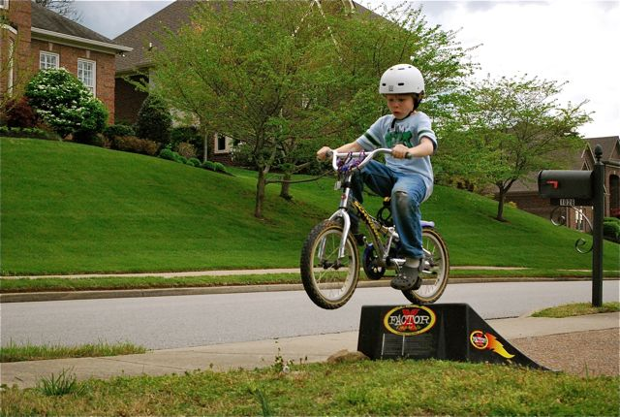
The Dearth in Doubt
Notes:
One thing about Doubt , it destroys courage at the time that it is most needed.
My Bicycle escapade in Perth.
<number>

Slide 5
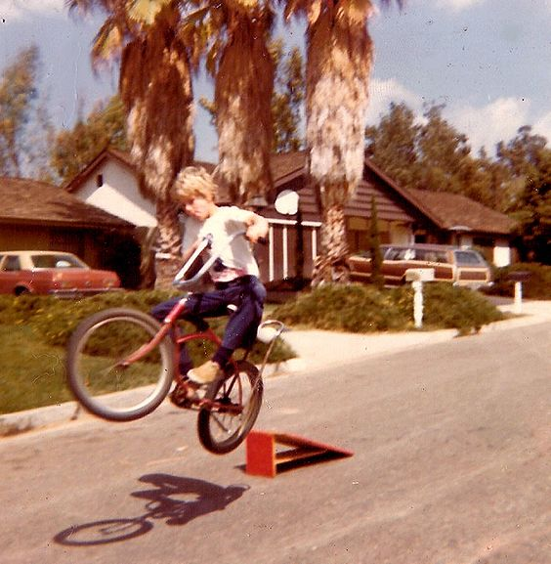
The Dearth in Doubt
Notes:
One thing about Doubt , it destroys courage at the time that it is most needed.
My Bicycle escapade in Perth.
<number>

Slide 6
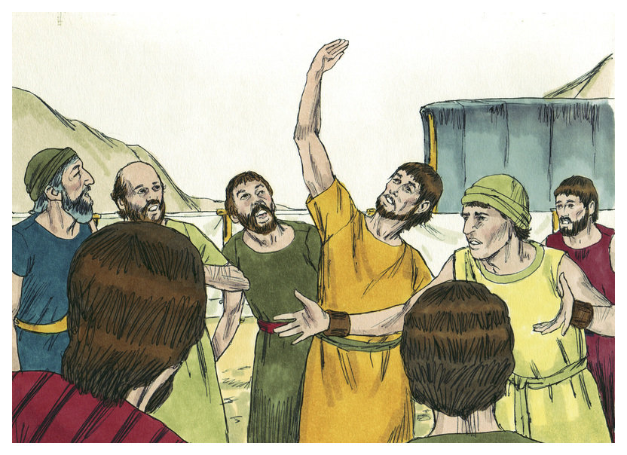
“We are not able to go up against the people, for they are stronger than we.”
Numbers 13:31
Notes:
But not only does Doubt Destroys Courage but it removes the Belief in God.
It often removes belief in God at the most crucial of times.
- Just as I was approaching the Bike ramp.
- Just at the time when Israel is about to enter Caanan.
- Just at the time when Thomas is about to be commissioned to spreading the gospel.
<number>

Slide 7
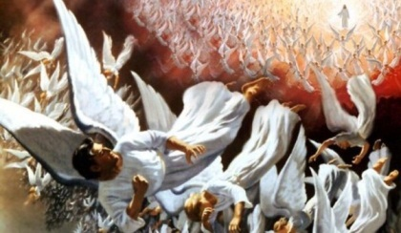
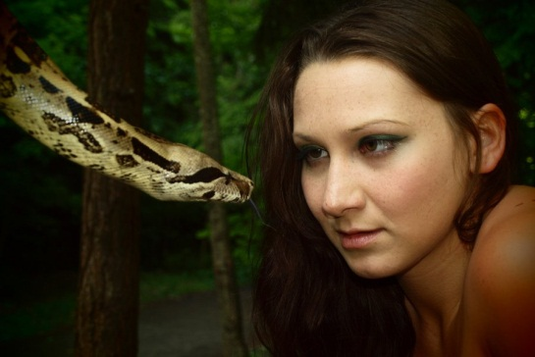
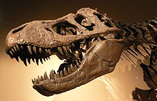
Doubt
Notes:
Doubt played a role in the War in Heaven
Satan put doubt in the heart of one third of the angels in heaven
Satan tempted eve and got her to doubt God
Theories like evolution come about as a result of doubt
<number>

Slide 8
Greek
Doubt
Distazo
Distadzo
Waiver / Hesitate
Hebrew → Dilemma
Notes:
For Old Testament text we usually look at ancient Hebrew or Aramaic text but I think that even the Greek gives us a good idea too.
And Elijah came unto all the people, and said, How long halt ye between two opinions? if the Lord be God, follow him: but if Baal, then follow him. And the people answered him not a word. 1 Kings 18:21 KJV
Amplified & ASV Bible actually uses the word “hesitate”
Elijah approached all the people and said, “How long will you hesitate between two opinions? If the Lord is God, follow Him; but if Baal, follow him.” 1 Kings 18:21
Neither Hot nor Cold Rev 3
I know your deeds, that you are neither cold nor hot; I wish that you were cold or hot. 16 So because you are lukewarm, and neither hot nor cold, I will [l]spit you out of My mouth. Revelation 3:15,16
The Hebrew word for “Doubt” brings in another dimension with a word that almost means “dilemma”
Deuteronomy 28 - “You shall always remain in dilemma”
<number>

Slide 9
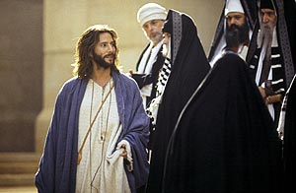
When evidence becomes a broken crutch
“an evil and adulterous generation asks for a sign”…….”
Matthew 21:38-42
Notes:
Doubt was present among the pharisees.
The pharisees asks for a sign.
Show me the evidence
In this situation Evidence nolonger is a support for truth but it rather becaomes a broken crutch on which to hang out unbelief, weaknesses.
<number>

Slide 10
Encapsulate
IT seems like truths can be explained in simple terms and untruths attracts complexity.
Parables of Jesus
–---------->>>>
Darwinistic type theories
Notes:
Illustrate that evidence is easy to encapsulate.
Illudtrate what encapsulate is using the evidence that the workd is round.
It is easy to put truth into simple terms eg Jesus parables.
Error has to be masked in many theories. Ask for the evidence of evolution.
Again evidence becomes a broken crutch to those who doubt.
Richard wrote the book “The God Delusion” simply to tell the world that all the problems in the world derives from people who believe in God or a god.
<number>

Slide 11
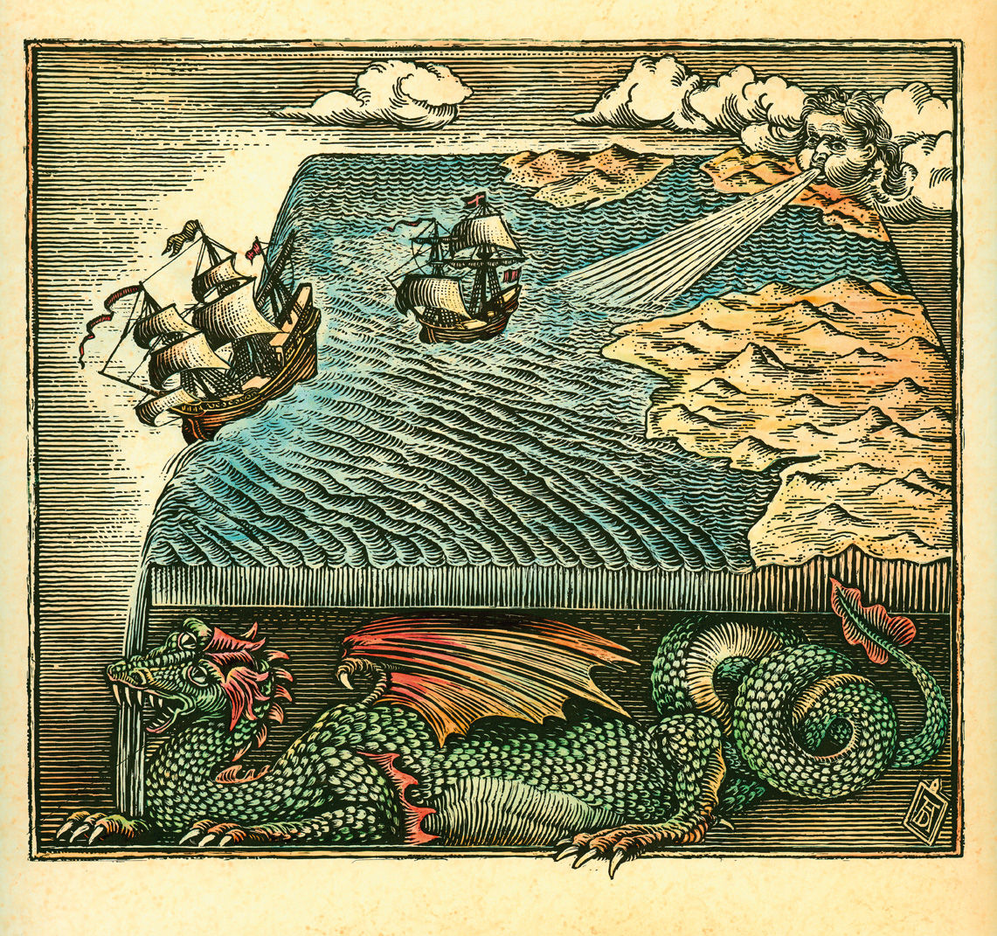
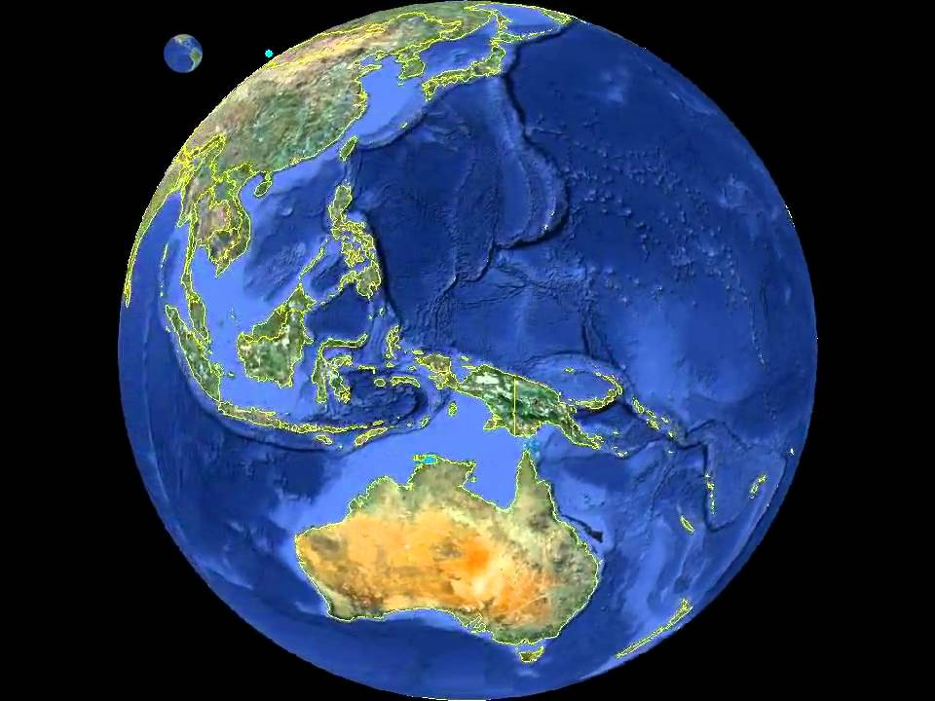
Encapsulation: “The earth is not flat but round like a ball”
The true shape of the Earth called an Oblate Spheroid. The term "Oblate" refers to it's slightly oblong appearance. The term "Spheroid" means that it is almost a sphere, but not quite.
Notes:
Illustrate that evidence is easy to encapsulate.
Illudtrate what encapsulate is using the evidence that the workd is round.
It is easy to put truth into simple terms eg Jesus parables.
Error has to be masked in many theories. Ask for the evidence of evolution.
Again evidence becomes a broken crutch to those who doubt.
Richard wrote the book “The God Delusion” simply to tell the world that all the problems in the world derives from people who believe in God or a god.
<number>

Slide 12
First give the signs(evidence) then we will believe.

Slide 13
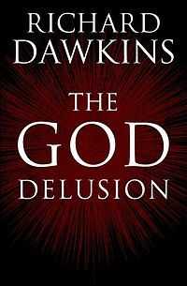
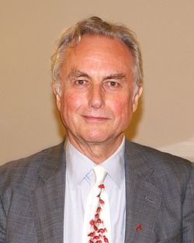
Richard Dawkins
In The God Delusion, Dawkins contends that a supernatural creator almost certainly does not exist and that belief in a personal god qualifies as a delusion, which he defines as a persistent false belief held in the face of strong contradictory evidence.
Notes:
Again evidence becomes a broken crutch to those who doubt.
Richard wrote the book “The God Delusion” simply to tell the world that all the problems in the world derives from people who believe in God or a god.
<number>

Slide 14
"While God has given ample evidence for faith, He will never remove all excuse for unbelief. All who look for hooks to hang their doubts upon will find them. And those who refuse to accept and obey God's Word until every objection has been removed, and there is no longer an opportunity for doubt, will never come to the light" (The Great Controversy, p. 527).
Notes:
A sad prospect awaits those who practice doubt instead of believe.
If you want to stubbornly go down the path of dibelief and doubt or if you want to persisit along a course of disbelief and doubt, you will start finding enough hooks on which to hang your garments of doubt. Things like evolution and similar theories become easier to “understand” when you persist on a course of doubt. When God tried to warn Eve about doubt and deception she persisted on a certain course
<number>

Slide 15
When evidence becomes a broken crutch
“So he said to them, “Unless I see in His hands the print of the nails, and put my finger into the print of the nails, and put my hand into His side, I will not believe.”
John 20:24,29
Notes:
Signs and wonders - “Evidence”
You see I first want all the evidence that Jesus can and will……
Before I believe and surrender all to Jesus…..
I am not willing to risk all on this this.
We go into defence mode keep ourselves “protected”, isolated, indifferent
We hold back and slow down just before we hit the ramp.
After all that Jesus has done for us.
After clearly demonstrating to Thomas and the disciples that “I am the Way the Truth and the Life “ – John 14:6
<number>

Slide 16
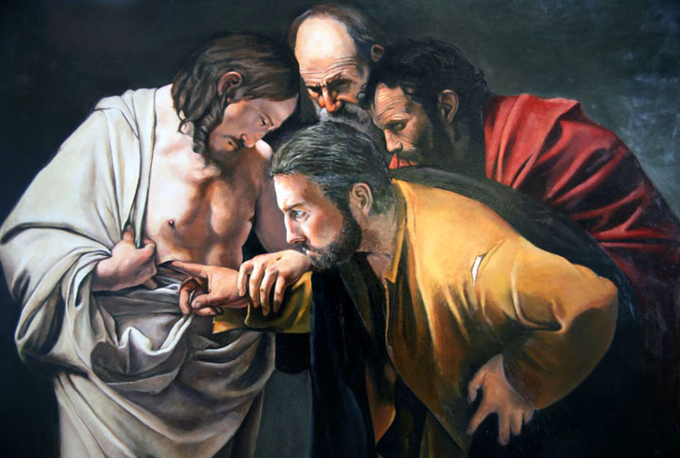
Thomas first wanted to see the evidence
Jesus said to him “ Thomas because you have seen Me, you have believed. Blessed are those who have not seen and yet have believed.”
John 20:29
Notes:
Thomas never spent enough time with christ and allowed belief to flourish. Instead he remained a skeptic relying on his perception of evidence.
Like Pharisees, Richard Dawkins Thomas also falls into this trap and asks for the evidence
Unlike Thomas and the Pharisees, the paralytic at the pool of Bethesda does not ask for evidence but immediately obeys.
The dearth/lack/under-resource is experienced when we do not believe Jesus at His word.
We distance our selves from a vital or THE Vital life force when we excersize doubt.
In this instance evidence does not assist or help but rather it hangs around likea broken crutch.
We become impoverished and bankrupt when we excersize doubt.
<number>

Slide 17
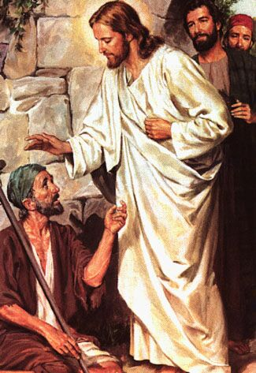
Signs and wonders is not the problem.
And truly Jesus did many other signs in the presence of His disciples, which are not written in this book; John 20:30,31
God never asks us to believe, without giving sufficient evidence upon which to base our faith.
Steps To Christ pg 105
Notes:
As we see in John 11:14,15 Jesus said “And I am glad for your sakes that I was not there, that you may believe. Nevertheless let us go to him.”
Jesus was very prepared to provide the Evidence, a sign, that He was the Son of God….The very One !!!
He had no problem providing Israel with Evidence before he asked them to Believe that He will provide the victory of Canaan with their Giants and All.
He had no problem providing even the Pharisees and Scribes with Evidence, or a Sign as they called it, with all the wonderful miracles
God has provided us with evidence of His omnipotence and supreme divinity in the natural world. The evidences of His design are boundless both in nature and in His Word.
God would not let Israel leave Egypt without evidence of power and glory.
Throughout the their journey to the promise land Israel continually experienced God’s presence and His power.
In the experience of Thomas and at the ressurection of Lazerus, Thomas saw that Jesus had power over death.
My Christian Friends today I tell you that Jesus has in no doubt provided the evidence.
BUT Do you really want to go through life testing everything that Jesus says ?
Always hesitating between dilemma ? Not finding peace and security in the words of Jesus but having to test your footing all the way through life's journery
.
Jesus has know problem providing you with the Evidence, but today He calls you to believe. Because believing is the key to life.
It is the key to eternal life.
When you believe you do not have to go through life testing every word.
Teach your children to trust in the words of Jesus
<number>

Slide 18
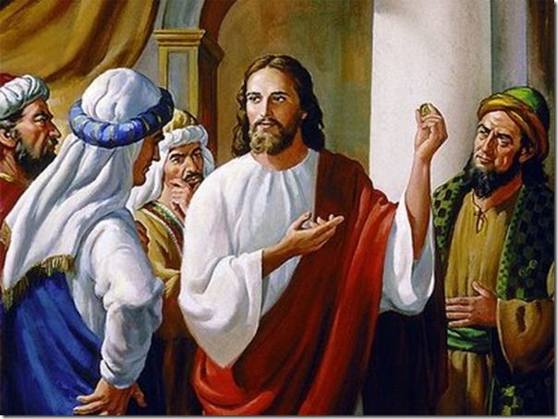
Opposite of doubt is Believe.

Slide 19
Greek
Believe
Pisteuo
To Credit
Have Confidence
Notes:
For Old Testament text we usually look at ancient Hebrew or Aramaic text but I think that even the Greek gives us a good idea too.
And Elijah came unto all the people, and said, How long halt ye between two opinions? if the Lord be God, follow him: but if Baal, then follow him. And the people answered him not a word. 1 Kings 18:21 KJV
Amplified & ASV Bible actually uses the word “hesitate”
Elijah approached all the people and said, “How long will you hesitate between two opinions? If the Lord is God, follow Him; but if Baal, follow him.” 1 Kings 18:21
Neither Hot nor Cold Rev 3
I know your deeds, that you are neither cold nor hot; I wish that you were cold or hot. 16 So because you are lukewarm, and neither hot nor cold, I will [l]spit you out of My mouth. Revelation 3:15,16
The Hebrew word for “Doubt” brings in another dimension with a word that almost means “dilemma”
Deuteronomy 28 - “You shall always remain in dilemma”
<number>

Slide 20
Believing not only provides surety for Eternal life but makes our day to day lives easier.
Boosts confidence in the “plans He has for us” Jeremiah 29:11
Thus we can move forward confidently when God commands us to.
Notes:
We will see in the Bible that the words or concepts of “Believe” and Salvation/ Eternal are very closely connected in the Bible
Believe in the Lord Jesus Christ and thou shall be saved Acts
whosever believe in Him shall not perish but shall have everlasting life John 3:16
…..by believing you may have life in His name. John 20:31
Truly, truly, I say to you, whoever hears my word and believes him who sent me has eternal life John 5:24
It is only Jesus who gives us confidence.
It is only Jesus who gives us hope.
It is only Jesus who removes doubt and fear.
It is only Jesus Who is Master over fear
Only Jesus is the Master over storms and over death
In response we …..just..need…to Believe,
<number>

Slide 21
Evidence places the ball in our court. We carry the burden
Believing places the ball in God's court. God carries the burden.
Notes:
We will see in the Bible that the words or concepts of “Believe” and Salvation/ Eternal are very closely connected in the Bible
Believe in the Lord Jesus Christ and thou shall be saved Acts
whosever believe in Him shall not perish but shall have everlasting life John 3:16
…..by believing you may have life in His name. John 20:31
Truly, truly, I say to you, whoever hears my word and believes him who sent me has eternal life John 5:24
It is only Jesus who gives us confidence.
It is only Jesus who gives us hope.
It is only Jesus who removes doubt and fear.
It is only Jesus Who is Master over fear
Only Jesus is the Master over storms and over death
In response we …..just..need…to Believe,
<number>

Slide 22
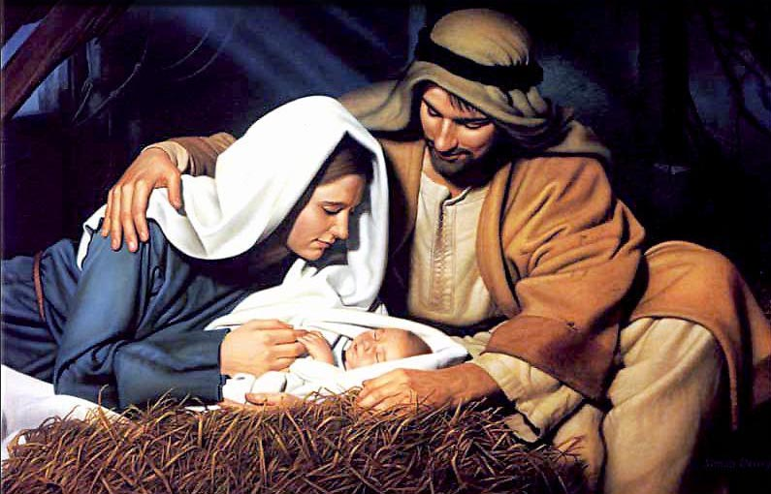
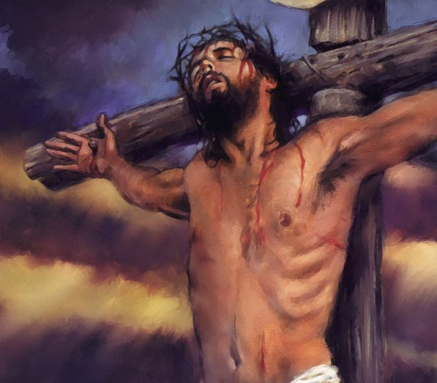
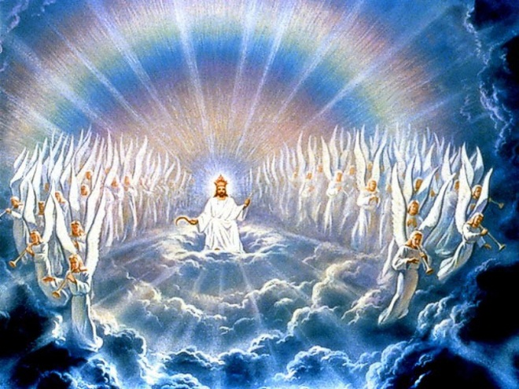
Whoever believes in Him should not perish but have everlasting life.
John 3:16
Darwinistic type theories
Notes:
And so we can see…
When it comes to the crunch.
When it comes to that crucial decisive point.
We have confidence that …..We can trust in the very words that Jesus gives us.
<<<Hold up the bible>>>>>>
<number>

Slide 23
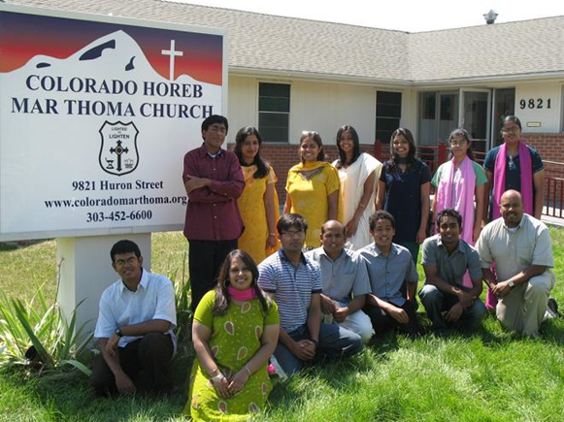
“My Lord and My God”
John 20:28
Notes:
Thomas realises that Jesus did provide the evidence all along.
The evidence of Jesus’s power over death was presented already at the resserection of Lazerus
So Thomas realises now that Jesus indeed has power over death.
As he contemplates the words “I am the ressurection and the life”
And the very benevolent ministry of Jesus comes flooding in his mind.
He becomes gripped and disgusted by his skeptic, unbelieving and doubting response to Jesus love.
He responds “MY LORD AND MY GOD !”
Thomas goes and spreads the Message of Jesus, His love and victory over death, All over Asia minor.
Thomas abandons skeptism and doubt and Believes and Trusts.
Thomas missionary work in Asia minor and his establishment of the church in India.
Thomas martyrdom in India
<number>

