Slide 1
Welcome to Church!

Slide 2
Grace for all

Slide 3
Luther in a storm

Slide 4
John Wycliffe

Slide 5
Jan (John) Hus

Slide 6
Martin Luther

Slide 7
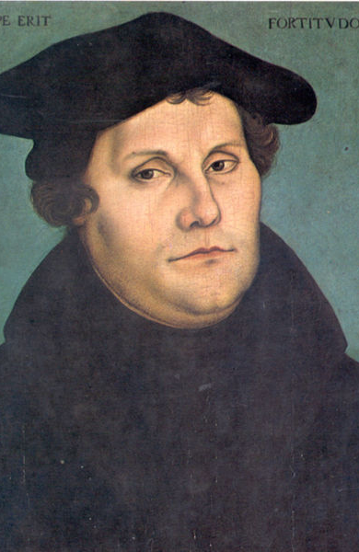
Indulgences

Slide 8
Romans 3
23 for all have sinned and fall short of the glory of God,
24 and all are justified freely by his grace through the redemption that came by Christ Jesus.

Slide 9
Indulgences
Papal infallibility

Slide 10
Matthew 16
18 And I tell you that you are Peter, and on this rock I will build my church, and the gates of Hades will not overcome it.
19 I will give you the keys of the kingdom of heaven; whatever you bind on earth will be[d] bound in heaven, and whatever you loose on earth will be loosed in heaven.”

Slide 11
Indulgences
Papal infallibility
Sacerdotalism

Slide 12
1 Peter 2
4 As you come to him, the living Stone—rejected by humans but chosen by God and precious to him
5 you also, like living stones, are being built into a spiritual house to be a holy priesthood, offering spiritual sacrifices acceptable to God through Jesus Christ.

Slide 13
Diet of Worms

Slide 14
Frederick III of Saxony

