Slide 1
“God saw all that he had made, and it was very good..”
Genesis 1:31, NIV

Slide 2
“God said, ‘Let us make mankind in our image.”
Genesis 1:26, NIV

Slide 3
“God blessed the seventh day and made it holy.”
Genesis 2:3, NIV

Slide 4
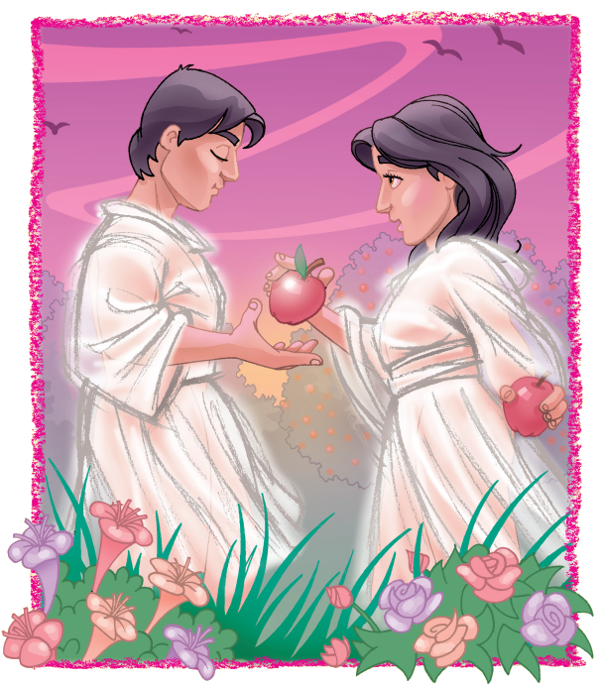
“The Lord is good and his love endures forever.”
Psalm 100:5, NIV

Slide 5
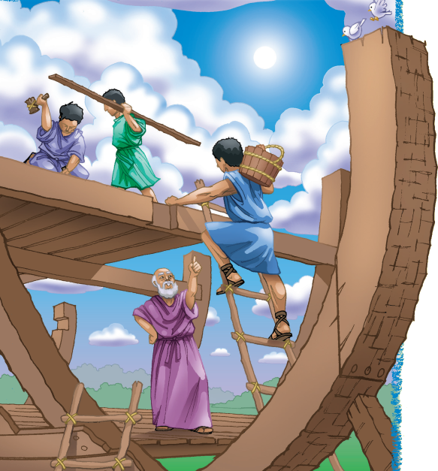
“We will obey the voice of the Lord.”
Jeremiah 42:6, NJKV

Slide 6
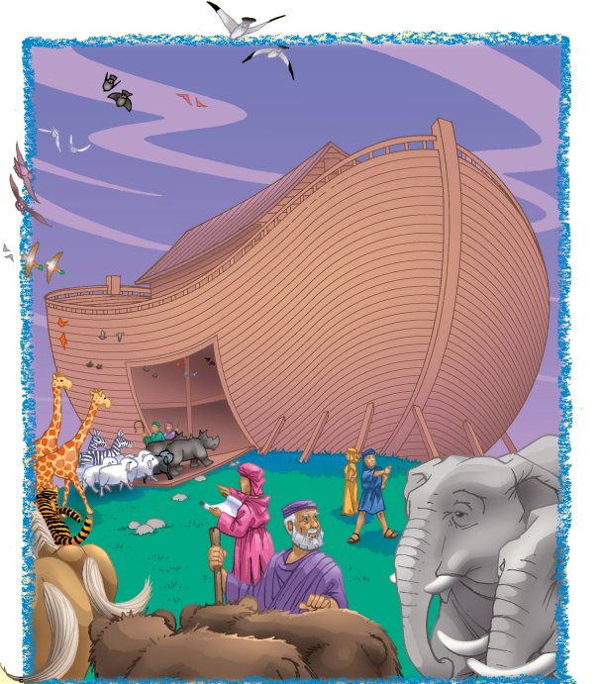
“For what you have done I will always praise you.”
Psalm 52:9, NIV.

Slide 7
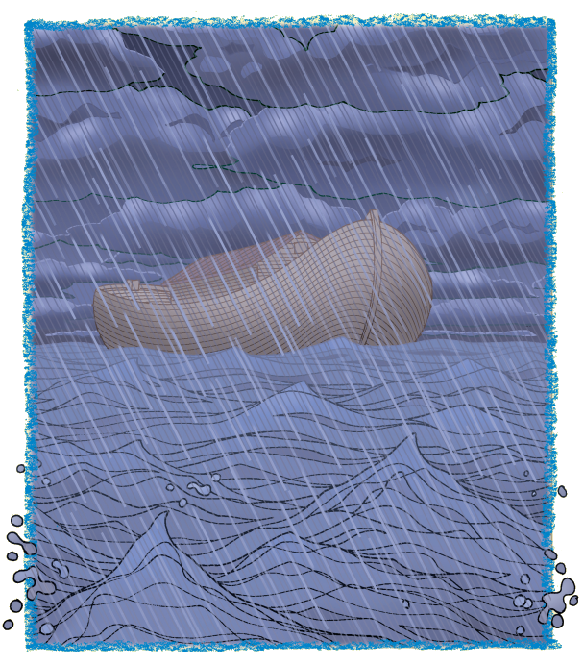
“Great is the Lord, and most worthy of praise.”
Psalm 48:1, NIV.

Slide 8
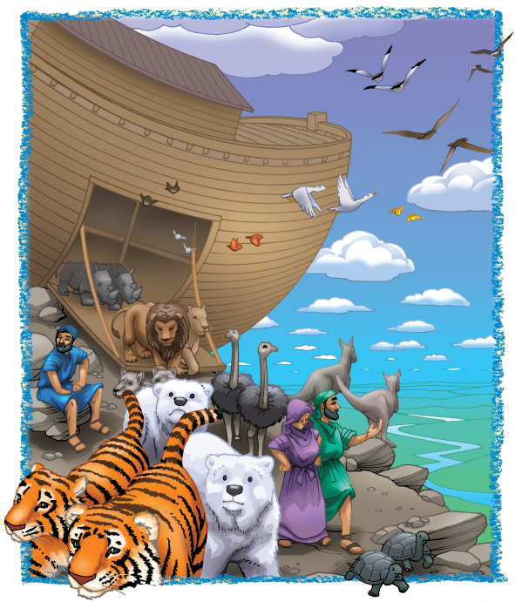
“I have set my rainbow in the clouds, and it will be [a]
sign.”
Genesis 9:13, NIV.

Slide 9
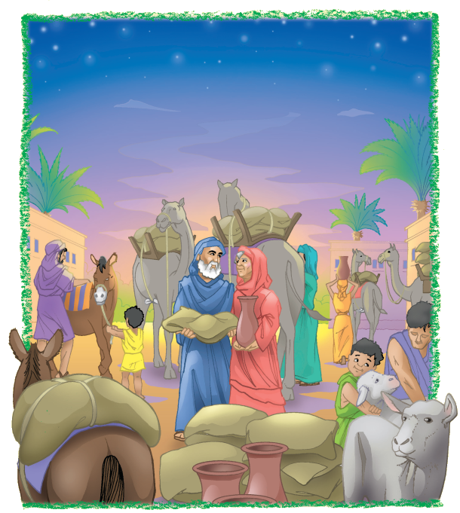
“Follow the way of love.”
1 Corinthians 14:1, NIV.

Slide 10
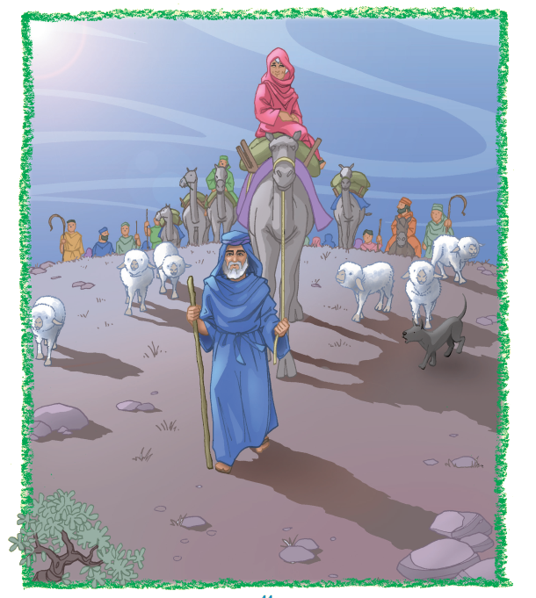
“Worship the Lord with gladness.”
Psalm 100:2, NIV.

Slide 11
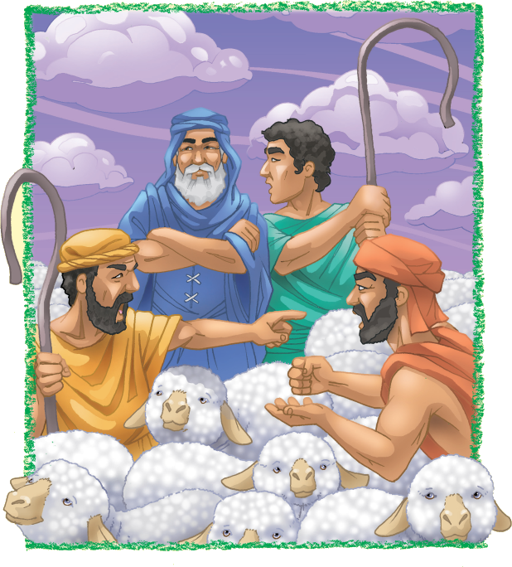
“Let’s not have any quarreling between you and me.”
Genesis 13:8, NIV.

Slide 12
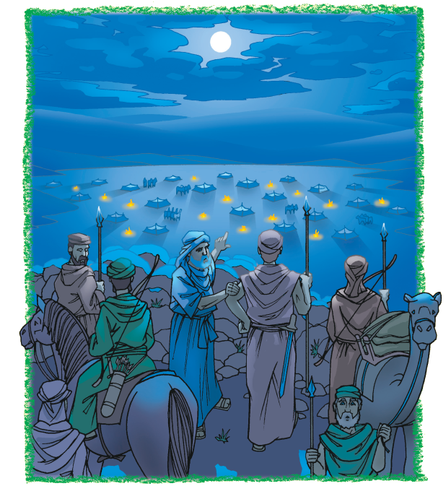
“I will accept nothing belonging to you.”
Genesis 14:23, NIV.

Slide 13
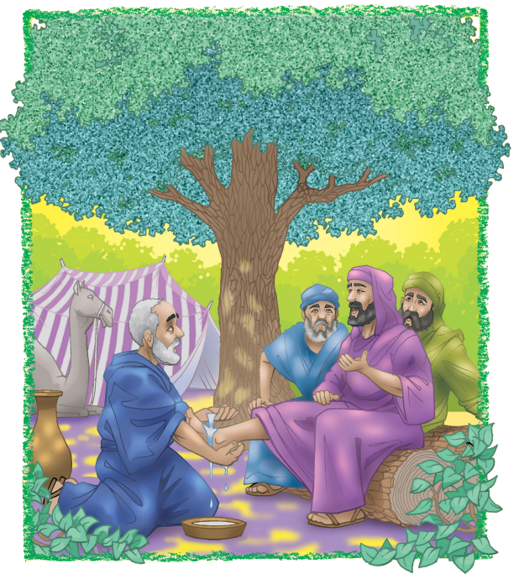
“Let us love one another, for love comes from God.”
1 John 4:7, NIV.

