Slide 1
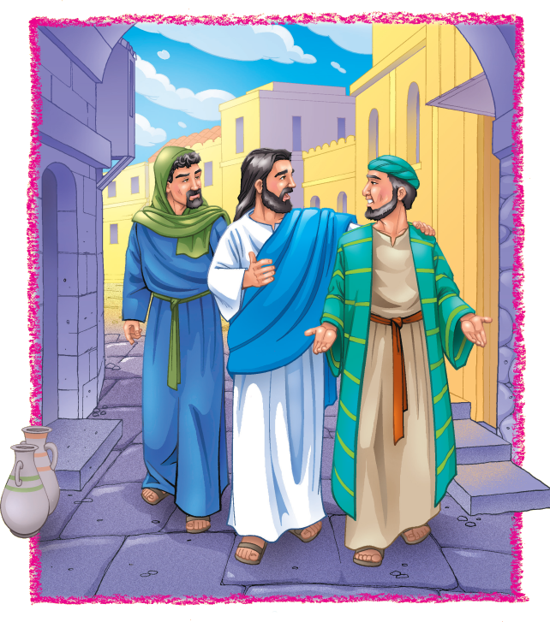
“Jesus said, “If any man desire to be first, the same shall be last of all, and servant of all.”
Mark 9:35

Slide 2
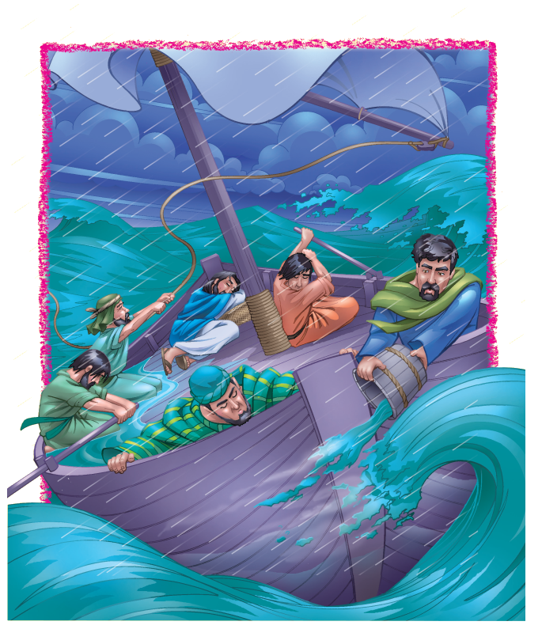
“The LORD is on my side; I will not fear : what can man do to me?”
Psalm 118:6

Slide 3
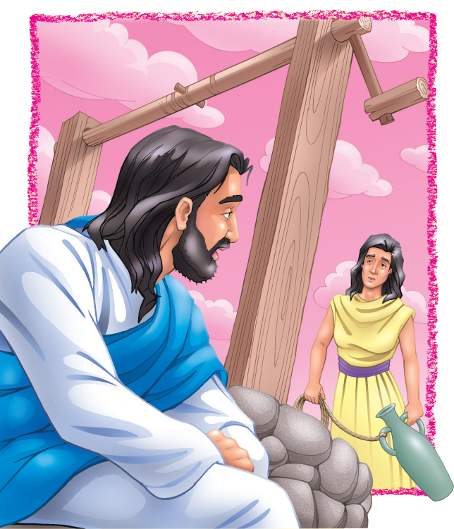
“Return to your house and show how great things God has done to you...”
Luke 8:39

Slide 4
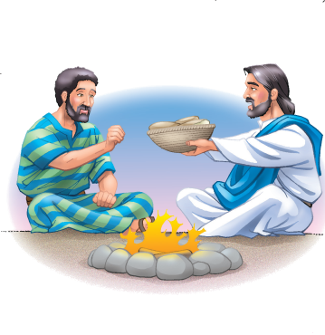
“I have given you an example, that you should do as I have done to you.”
John 13:15

Slide 5
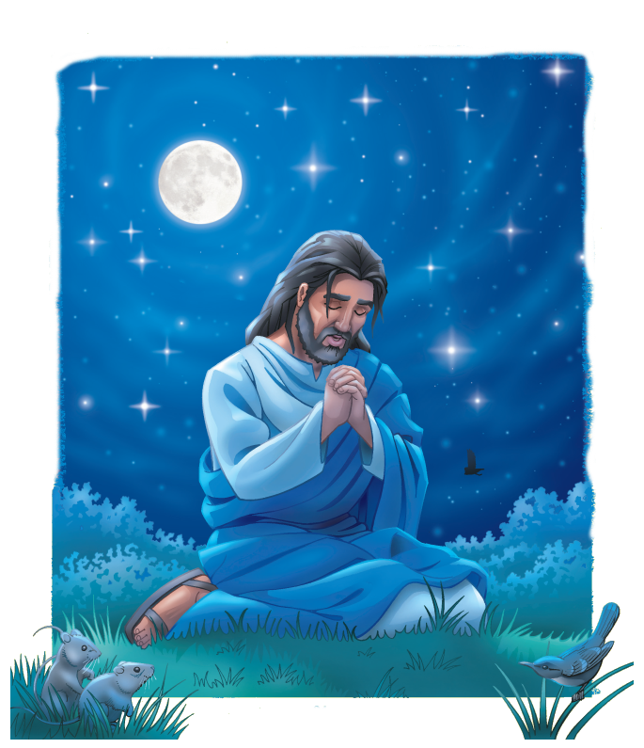
“Then shall you call upon Me, and you shall go and pray to Me, and I will
hear you.”
Jeremiah 29:12

Slide 6
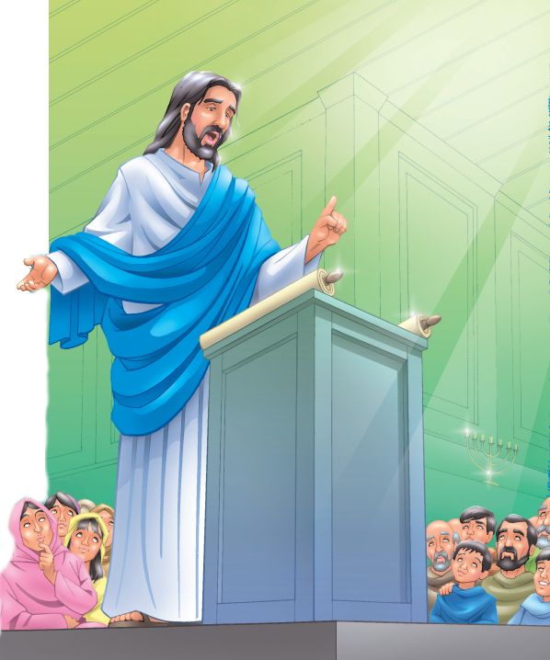
“I was glad when they said to me, ‘Let us go into the house of The LORD.’”
Psalm 122:1

Slide 7
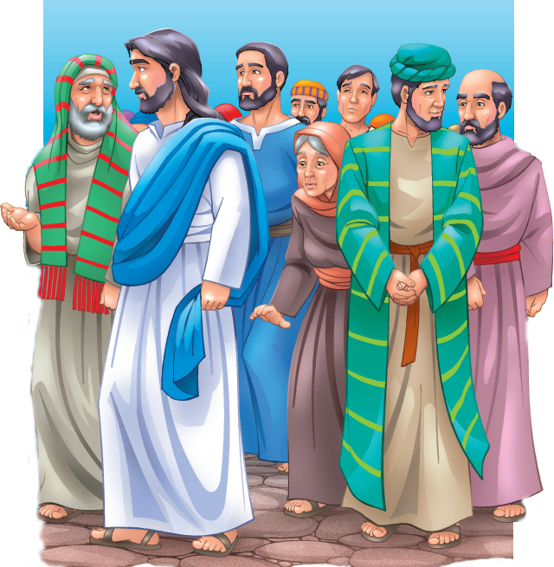
“Give thanks to The LORD. Call upon His name. Make know His deeds among the people.”
1 Chronicles 16:8

Slide 8
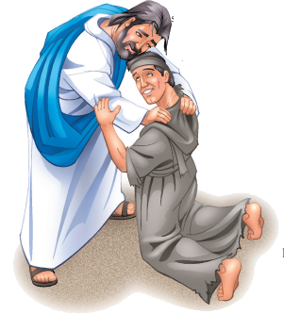
“O LORD my God, I will give thanks to You forever.”
Psalm 30:12

Slide 9
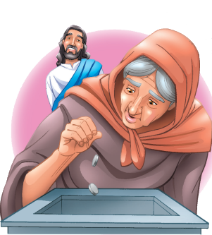
Every man according as he purposes
in his heart,
so let him give;
not grudgingly,
or of necessity:
for God loves a cheerful giver.
2 Corinthians 9:7

Slide 10
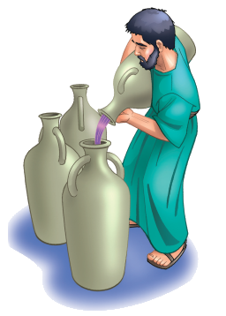
“Break forth into joy. Sing together...for The LORD has…redeemed His people.”
Isaiah 52:9

Slide 11
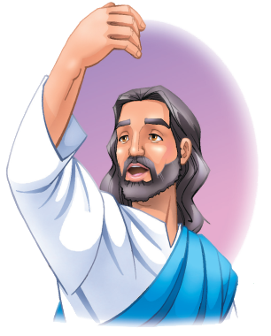
“Ye are my friends,
if ye do whatsoever
I command you.”
John 15:14

Slide 12
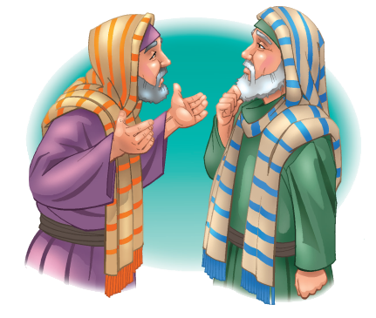
“A friend loves at all times and a brother is born for adversity.”
Proverbs 17:17

Slide 13
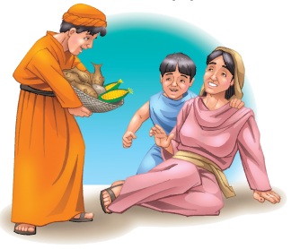
“But to do good and to communicate forget not: for with such sacrifices,
God is well pleased.”
Hebrews 13:16

