Slide 2
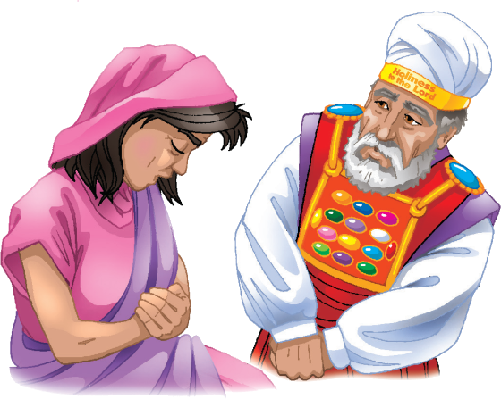
“Then Eli answered and said, “Go in peace and the God of Israel grant you your petition that you have asked of Him.”
1 Samuel 1:17

Slide 3
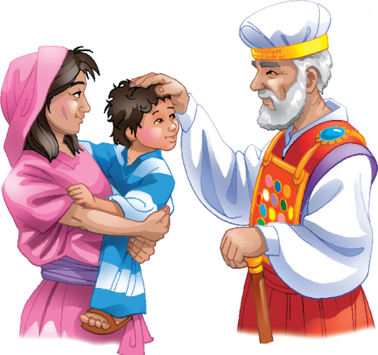
“Therefore I have also lent him to The LORD, and as long as he lives he shall be lent to The LORD. And he worshipped The LORD there.”
1 Samuel 1:28

Slide 4
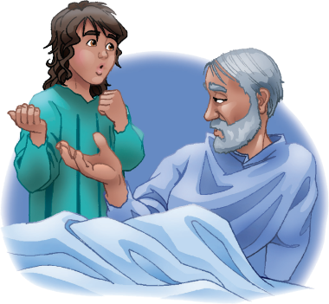
“Eli said to Samuel, ‘Go, lie down: and it shall be, if He call you, that you shall say, ‘Speak, LORD; for your servant hears.’ ’ So Samuel went and lay down in his place”
1 Samuel 3:9

Slide 5
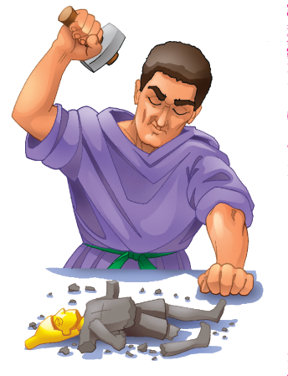
“And Samuel judged Israel all the days of his life.”
1 Samuel 7:15

Slide 6
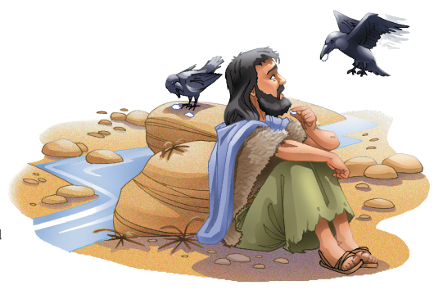
“But my God shall supply all your need according to His riches in glory by Christ Jesus.”
Philippians 4:19

Slide 7
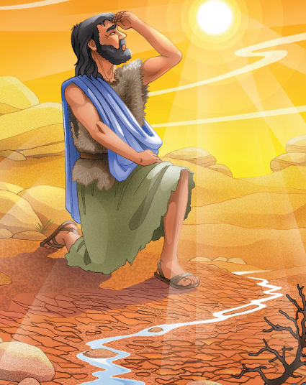
“For He is our God; and we are the people of His pasture, and the sheep of His Hand.”
Psalm 95:7

Slide 8
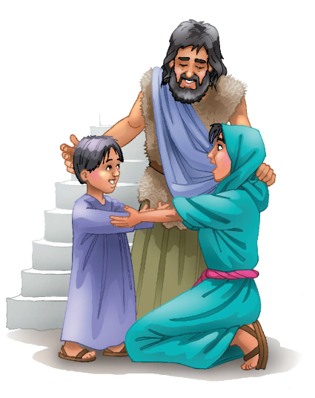
“The LORD is good, a strong hold in the day of trouble; and He knows them that trust Him.”
Nahum 1:7

Slide 9
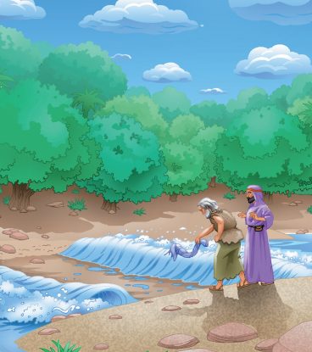
“O God, You are terrible out of Your holy places: the God of Israel is He that gives strength and power to His people. Blessed be God.”
Psalm 68:35

Slide 10
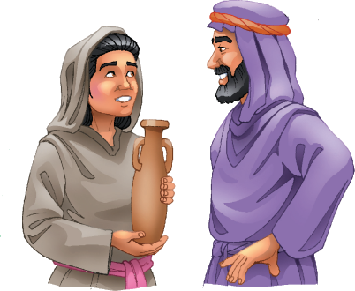
“Elisha said to her, ‘What shall I do for you?’ And she said, ‘Your handmaid has not anything in the house save a pot of oil.’ ”
2 Kings 4:2

Slide 11
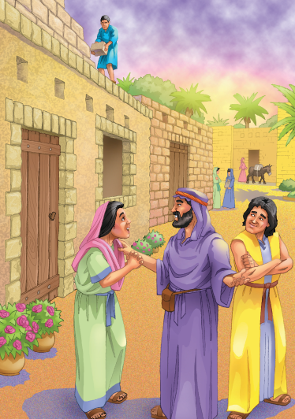
“If they fall, the one will lift up his fellow: but woe to him that is alone when he falls; for he has no-one to help him up.”
Ecclesiastes 4:10

Slide 12
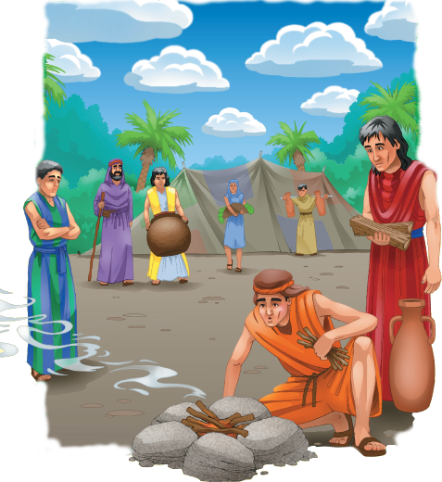
“David said to him, Fear not: for I will show you kindness for Johnathan your father’s sake, and will restore to you all the land of Saul your father; and you shall eat bread at my table continually.”
2 Samuel 9:7

Slide 13
“Brethren, you have been called to liberty; only use not liberty for an occasion to the flesh, but by love serve one another.”
Galatians 5:13

Slide 14
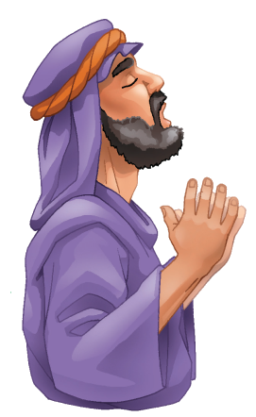
“Confess your faults one to another, and pray for one another, that you may be healed. The effectual fervent prayer of a righteous man avails much.”
James 5:16

