Slide 2
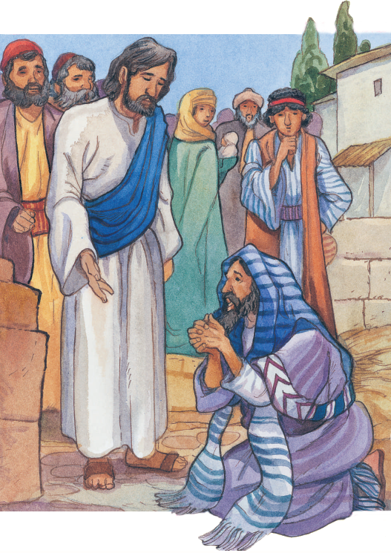
“Beloved, I wish above all things that you may prosper and be in health, even as your soul prospers.”
3 John 1:2

Slide 3
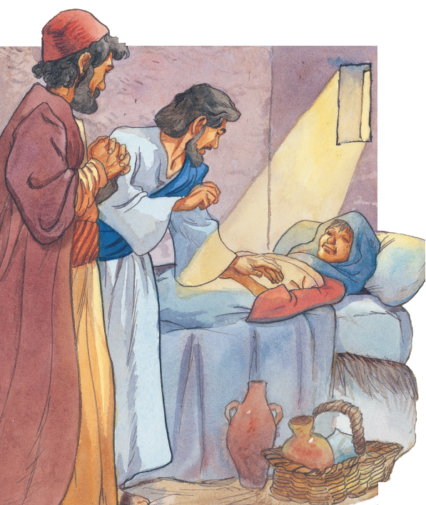
“I was naked, and you clothed me: I was sick, and you visited me: I was in prison, and you came to me.”
Matthew 25:36

Slide 4
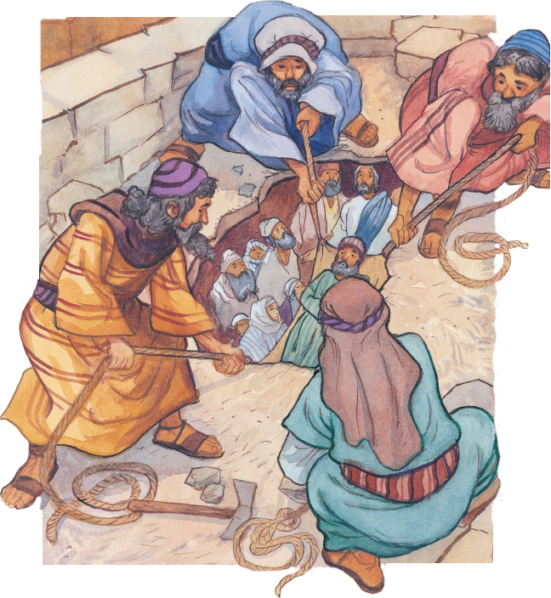
“A man that has friends must show himself friendly: and there is a friend that sticks closer than a brother.”
Proverbs 18:24

Slide 5
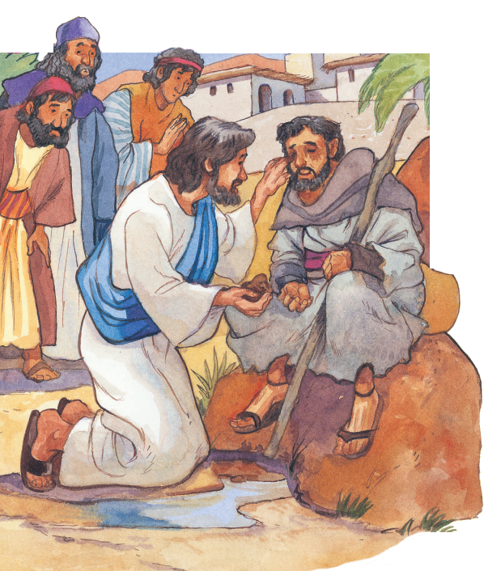
“He answered and said, Whether he be a sinner or not, I know not: but one thing I know, that, whereas I was blind, now I see.”
John 9:25

Slide 6
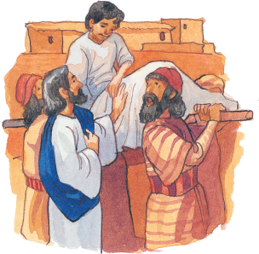
“And there came a fear on all: and they glorified God, saying, That a great prophet is risen up among us; and, That God has visited his people.”
Luke 7:16

Slide 7
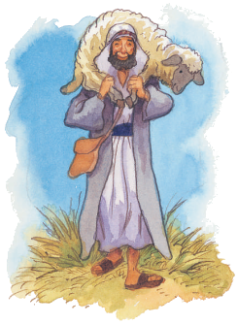
“Teach them to observe all things whatsoever I have commanded you: and, lo, I am with you always, even unto the end of the world. Amen.”
Matthew 28:20

Slide 8
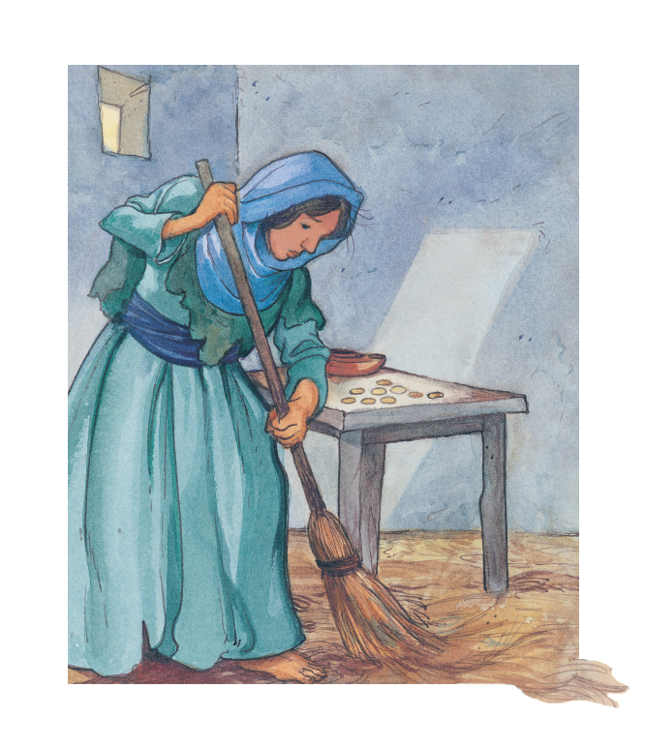
“The LORD has appeared of old to me, saying, Yes, I have loved you with an everlasting love: therefore with lovingkindness have I drawn you.”
Jeremiah 31:3

Slide 9
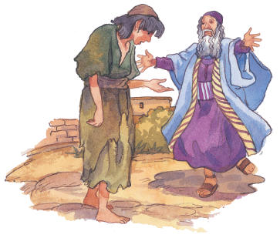
“For You, Lord, are good, and ready to forgive; and plenteous in mercy to all them that call upon You.”
Psalm 86:5

Slide 10
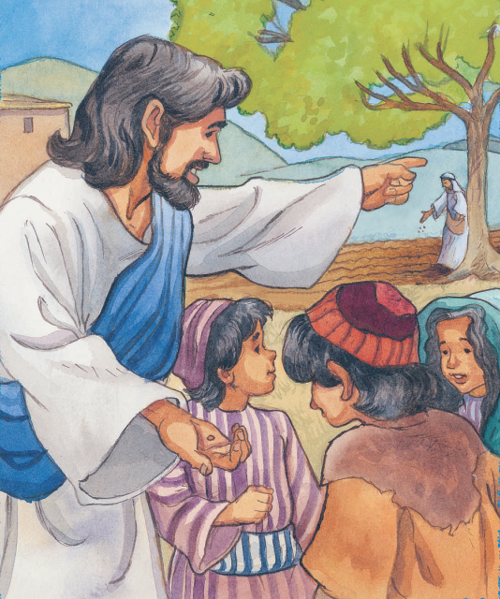
“But grow in grace, and in the knowledge of our Lord and Saviour Jesus Christ. To Him be glory both now and forever. Amen.”
2 Peter 3:18

Slide 11
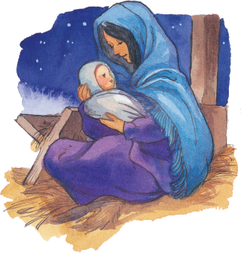
“Thanks be to God for his unspeakable gift.”
2 Corinthians 9:15

Slide 12
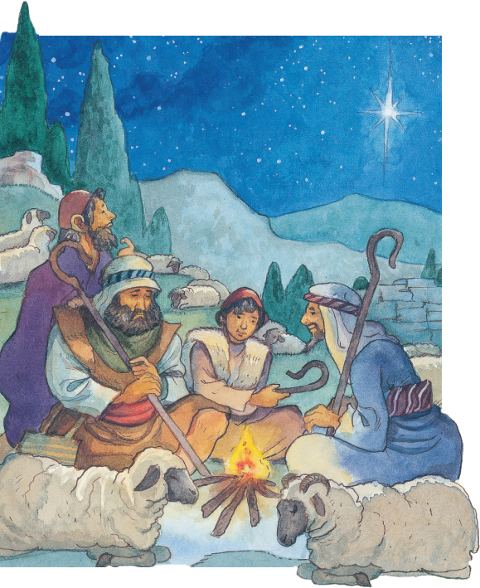
“Every good gift and every perfect gift is from above, and comes down from The Father of lights, with whom is no variableness, neither shadow of turning.”
James 1:17

Slide 13
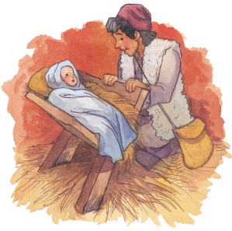
“The LORD has done great things for us; whereof we are glad.”
Psalm 126:3

Slide 14
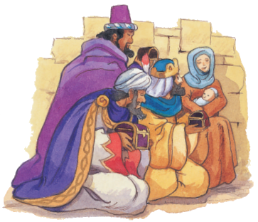
“And when they were come into the house, they saw the young child with Mary his mother, and fell down, and worshipped him: and when they had opened their treasures, they presented to him gifts; gold, and frankincense, and myrrh.”
Matthew 2:11

