Slide 1
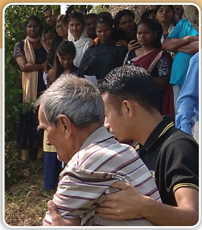
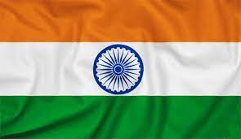
Week 12
INDIA
March 23
Glad to Be Alive
Shiva

Slide 2
Shiva only prayed to traditional gods and goddesses in India. For him, there was no other way of life.
He was surprised when his adult daughter, Arati, decided to believe in another God named Jesus. Shiva was suspicious about this new God.
But he stopped worrying when he saw that positive changes occurred in Arati’s life as she prayed to Jesus.
Still, he only prayed to his gods and goddesses. He was an old man, and he didn’t see any need for this new God.
Then Shiva took a bad fall at home. His daughter rushed him to the hospital and, after a few days, brought him back home to care for him. When she talked with friends on the phone, Shiva could hear her pray for his health.
After three months, Shiva fully recovered. He kept praying to his gods and goddesses.
Then he took another bad fall. This time he was hospitalized for 15 days. He had suffered a hairline rib fracture, and the physician recommended total bedrest.
When he returned home, his health started deteriorating.
His daughter, Arati, was worried, and she took him to a Seventh-day Adventist lifestyle center.

Slide 3
Under the care of an Adventist physician, Shiva slowly began to regain his strength. A young man named Mark cared for Shiva in his room. Shiva was especially appreciative of Mark. He was very kind and very caring. Through Mark, Shiva gained a sense of Jesus’ love for the first time. He saw Jesus through Mark’s kindness.
Shiva went to church worship services every Saturday for the four months that he stayed at the center. He learned about Jesus. He learned about the Sabbath. He learned about the importance of good nutrition.
One day, a visiting preacher gave a sermon that touched Shiva’s heart. Shiva felt a strong desire to give his heart to Jesus.
But then family issues diverted Shiva’s attention from spiritual matters. He forgot about his desire to live for Jesus. His health began to deteriorate again.
With the help of the Adventist physician and Mark, Shiva managed to get his strength back.
It was then that Shiva noticed a pattern. Every time he went away from Jesus, he appeared to suffer health challenges. Every time he went his own way, he fell or faced other struggles.
He sensed that Jesus didn’t want him to go his own away. It seemed like Jesus was calling him to stay nearby.
Shiva decided at that moment to give his heart to Jesus.
He called his daughter.

Slide 4
“Before I die tomorrow, it would be better to accept Jesus as my personal Savior today,” he said.
Exactly 10 months after Shiva took his first bad fall, he gave his heart to Jesus. His old life was washed away in the waters of repentance. The 78-year-old man emerged from the waters of an Indian river as a new child of Christ.
Today, Shiva no longer prays to the gods and goddesses.
He prays only to the God of heaven.
“Jesus has helped me to stop smoking and drinking black tea,” he said. “I am better and feel healthy and pray three times a day.”
He thanks Jesus for keeping him alive even today.
“I’m grateful to Jesus that my daughter took me to that lifestyle center,” he said. “Otherwise, I wouldn’t have known Jesus and gotten a chance to accept Him as my personal Savior.”
Thank you for your Sabbath School mission offerings that help share Jesus’ love with people in India and around the world. Thank you for your Thirteenth Sabbath Offering that will specifically go to projects in India and Nepal on March 30.

