Slide 1
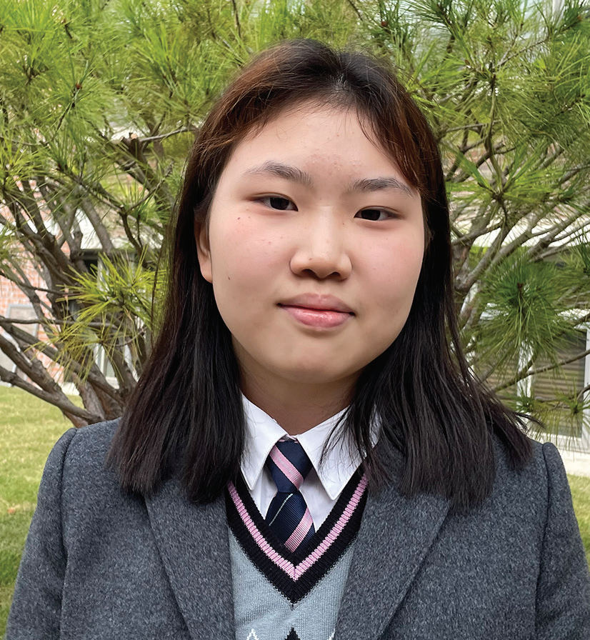
13th Sabbath
SOUTH KOREA
March 29
Meeting God At School
Hyun-hee

Slide 2
Ever since she was a small girl, Hyunhee [HYOUNG-hee] felt like she had to go to church on Sabbath. Her father was the pastor of a small church in South Korea, and she couldn’t stay at home or do whatever she wanted.
As time passed, Hyun-hee grew tired of church and being a pastor’s daughter. She couldn’t understand why Dad answered the phone late at night and even worked on weekends and holidays. Feelings of bitterness and resentment filled her heart when a long-awaited family vacation was canceled because Dad, as the church pastor, couldn’t miss a funeral. She began to question her faith.
It was then that the 16-year-old girl arrived at a Seventh-day Adventist high school in South Korea’s capital, Seoul. For the first time, she was far from home, living in a dormitory. For the first time, she was studying at an Adventist school. There was no Adventist school in the town where her parents lived.
At first, the Adventist school seemed to be the same as public school with the exception that the teachers believed in God and the students gathered regularly for worship.
At morning worship, however, Hyun-hee heard an announcement about something called “Kneelers.” She was curious to know more and, because she was shy, asked another girl to go with her to “Kneelers.”
“Kneelers” turned out to be a student led prayer meeting in the conference room of the Adventist middle school located on the same campus as the high school. The conference room had pews like a church.

Slide 3
About 30 teens, half girls and half boys, were sitting in the pews and singing when Hyun-hee and her friend arrived. A boy was playing a piano.
Hyun-hee’s mouth dropped open. She usually didn’t sing during song service in her home church. She was the only teen there. But these teens were singing loudly. She had never seen such enthusiasm. Tears filled her eyes. She was homesick, and the music was like balm to her soul. In an instant, all her loneliness disappeared, and she felt at peace.
After the last song, the young people knelt and prayed silently for a moment. Then several teens took turns speaking about what God was doing in their lives.
Hyun-hee’s mouth dropped open again. She had never heard people her age talk about God in such a personal way. She thought, “They’re young, but they have faith and believe in God. They love God despite the struggles in their lives.”
After that, the teens divided into small groups for prayer. At her home church, Hyun-hee’s mind usually drifted off to other things during a prayer. But these teens clearly enjoyed praying, and they spoke to God with passion and earnestness. Her mouth dropped open again.
As the hourlong meeting ended with more songs, Hyun-hee thought with astonishment, “These young people are more sincere and devoted to God than me.” She couldn’t wait for the next meeting. She thought, “This is living faith. I have found it. This is how Christians really live.”

Slide 4
As she kept going to the weekly “Kneelers” meeting, she discovered joy in worshiping God. She began to spend hours
with Him, singing, listening to worship songs, and praying. She sensed God’s presence for the first time. She wept as she
reflected on Jesus’ incredible love and sacrifice on the cross.
As time passed, she saw that teens and teachers alike prayed earnestly and praised God even amid problems. She got involved in various spiritual programs at the school and joined a student-led Bible study group.
As she wrapped up her first year at the high school, Hyun-hee found great joy in the worship programs. She eagerly participated in the weekly prayer meeting, the Bible study group, and other spiritual activities. Church was no longer tiring, and she looked forward to going every Sabbath.
Her favorite Bible passage is Philippians 4:4–7, which says, “Rejoice in the Lord always. Again I will say, rejoice! Let your gentleness be known to all men. The Lord is at hand. Be anxious for nothing, but in everything by prayer and supplication, with thanksgiving, let your requests be made known to God; and the peace of God, which surpasses all understanding, will guard your hearts and minds through Christ Jesus” (NKJV).
She believes that God sent her to the Adventist high school to teach her to live according to those verses.
“God saw my wavering faith and helped me to understand His purpose,” she said. “I met God at the school, and I have learned to thank Him for everything.”

Slide 5
Hyun-hee goes to Hankook Sahmyook Academy, which will receive part of today’s Thirteenth Sabbath Offering to open a missionary training center and gym in Seoul, South Korea. Today’s offering also will support four other projects in the Northern Asia-Pacific Division, including a shelter for single mothers in Ansan, South Korea; after-school centers at 14 schools in Japan; a children’s recreation center in Ulaanbaatar, Mongolia; and the establishment of an Adventist elementary school system in Taiwan. Thank you for your generous offering.

Slide 6
