Slide 1
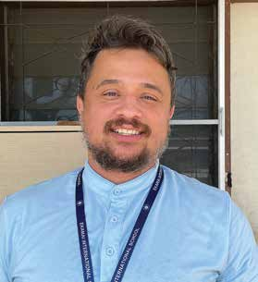
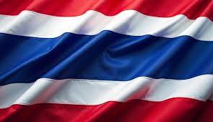
THAILAND
April 26
Setting
Prisoners Free
Renato

Slide 2
On a Friday night, Renato was reviewing the sermon that he had prepared to preach the next day for his 37th birthday.
A native of Brazil, he was in the middle of his first year as a missionary teacher in Thailand, and he had asked the pastor if he could preach for his birthday.
“I’m far from home,” he had said. “I don’t know what to do for my birthday. Please let me preach. That is the only way I can celebrate my birthday.”
But as Renato was looking over his sermon notes, he got a phone call from the headquarters of the South American Division in Brazil.
It seemed that God had something else in mind for Renato’s birthday.
“Could you go to the Bangkok airport?” asked the caller. It was a departmental director at the South American Division. “A former Seventh-day Adventist member has been arrested there for drug trafficking.”
Renato’s heart was touched by the caller’s concern. Brazil was far from Thailand, but a Brazilian church leader was worried about a former church member who had been arrested in Thailand.
“We need a missionary to visit this boy and pray with him,” the departmental director said. “Maybe you can give him a Bible. We need someone to hug him.”

Slide 3
Renato put aside the sermon notes and went to the airport. He didn’t understand the Thai language very well and wasn’t sure how he would communicate with the police. He also felt anxious and even a little afraid about going to the police to talk about someone whom he didn’t know.
At the airport, the police said he had arrived too late. The young man had already been transferred to another location.
There was nothing he could do at the airport.
Several weeks passed, and Renato received another phone call. This time it was from the young man’s lawyer in Brazil.
She said her client was in a prison not far from Bangkok and asked if Renato could visit him.
Renato went.
It was the first of what became many regular visits to the prison.
Sometimes the young man needed food. Pork and seafood, which are popular dishes in Thailand, were served often at the prison, but the young man didn’t eat unclean food. The young man’s mom called Renato and together they looked for food that Renato could bring to the prison.

Slide 4
The young man acknowledged to Renato that he had made a big mistake, and he expressed a desire to make things right with God. The two spoke about God and his love.
After some time, the young man’s lawyer asked Renato to visit another Brazilian prisoner who was also her client in the Thai prison. So, Renato, who had arrived in Thailand to teach 100 fourth grade children at an Adventist school, also became a missionary to two Brazilian inmates in a Thai prison. Today, he visits the two men every month and is ready to meet with other foreign inmates if God provides the opportunity.
“I pray for their hearts to be changed,” he said. “Maybe in the future we will see the fruit of these prayers.”
He asked church members worldwide to join him in prayer.
“Pray for these two guys and also for every foreigner in prison in Thailand,” he said. “It would be wonderful if they had the chance to meet God.”
Pray for prisoners in Thailand and around the world — including every person who is chained to the burden and guilt of sin. Pray for Adventist missionaries like Renato as they proclaim the good news that Jesus died to set prisoners free from sin. Thank you for your Thirteenth Sabbath Offering this quarter that will help spread the gospel in the Southern Asia-Pacific Division, which includes Thailand.
By Andrew McChesney

Slide 5
