Slide 1
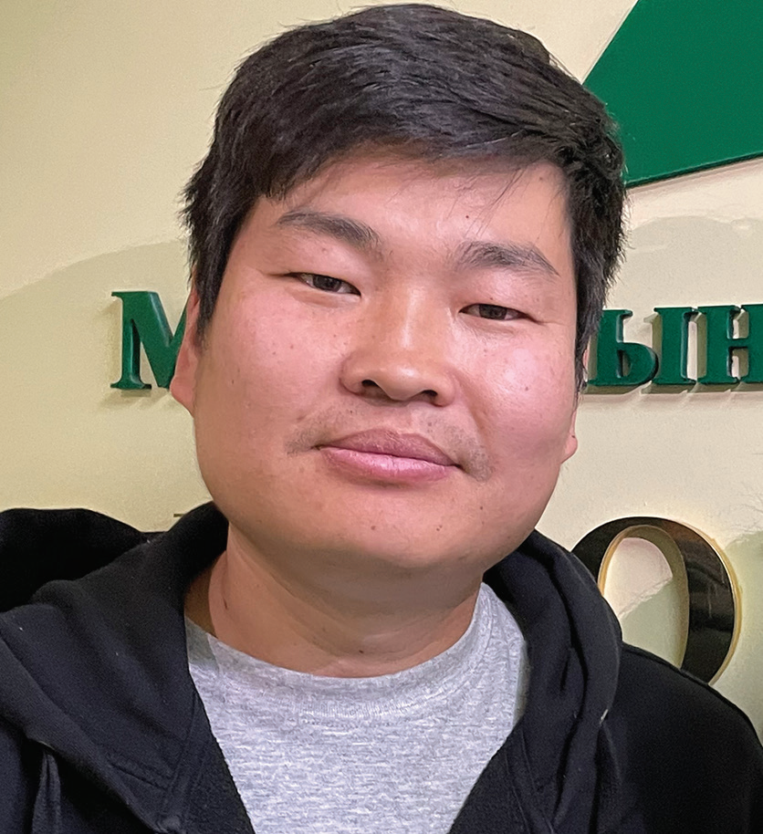
MONGOLIA
JANUARY 4
Something
Different
Tsomo

Slide 2
Tsomo [TSO-mo] never had any interest in Christianity. It was not Mongolia’s traditional religion. Moreover, he didn’t believe in any God. He was an atheist.
Then his aunt visited a Seventh-day Adventist church in Mongolia’s capital, Ulaanbaatar. Wanting to learn English, she had gone to evangelistic meetings led by a guest speaker from Australia. Something about the Adventist church was different, and she invited her 18-year-old nephew to come. “This is a really nice place,” she said. “There are a lot of young people like you.”
“Oh no, Auntie,” Tsomo said. “That’s not our traditional religion. It’s a foreign religion.”
But she still kept inviting him to church. She spoke about the young people and how they played the guitar and sang.
“They’re nice,” she said.
Tsomo went to church with his aunt. He liked the Australian speaker and his companions. He had never met foreigners before, and they were interesting. Moreover, he enjoyed the music. It was so nice. Like his aunt, he sensed something different about the church. He felt something he had never felt before. “These are really nice people,” he thought. “They’re always smiling.”
Tsomo went back to the church many times after the first visit. He became an Adventist. A desire grew in his heart to share his love for Jesus. But how?

Slide 3
A year after becoming an Adventist, Tsomo went to the countryside to visit friends. All of the local teens knew him, and they noticed that something was different.
“You are so different compared to before,” said a girl.
“You’ve changed,” said a boy.
“What happened?”
“I’ve met God,” Tsomo said.
The teens laughed. They weren’t Christians, and they didn’t believe in God.
Now at that time, no rain had fallen in the area for six months. The grass was brown and dry. This was a problem. Grass was needed to feed the horses, cows, sheep, goats, and camels that Mongolians rely on for food, wool, and transportation.
A miracle was needed to end the drought, and the teens decided to test Tsomo’s God.
“If your God really exists, you should pray for rain,” one boy said.
Others agreed.

Slide 4
“Let’s see what your God can do,” said another boy.
Tsomo called together all of the teens.
“OK, let’s do it,” he said. “Let’s pray together.”
He prayed to God for rain.
The next morning, the rain came. The raindrops fell lightly at first, but then the heavens opened up and it poured.
The teens were so surprised! They came running to Tsomo, exclaiming, “It’s raining! It’s raining!”
Some of them began to believe in God.
“Wow, your God is real,” said one.
“I want to know more,” said another.
Tsomo formed a small group of 10 teens. He read the Bible to them, he prayed with them, and he taught them Christian songs. The group met every day for a month. Then Tsomo returned to his home in the city.
Several years have passed since the miraculous rain. Tsomo became an Adventist pastor and today serves in

Slide 5
Mongolia’s capital, Ulaanbaatar. No Adventist church has been established in the region where the miracle took place. But the young people who witnessed the rain remain faithful to God. Several of their parents also have accepted God.
“There is no church there, and there is no pastor there, but they believe in God even today,” Tsomo said.
They believe after seeing something different about the God of heaven.
Part of your Thirteenth Sabbath Offering will go to a new children’s recreation center in Mongolia’s capital, Ulaanbaatar, where children and their parents will be able to learn that something is different about the God of heaven. Thank you for planning a generous offering for this Thirteenth Sabbath project on March 29

Slide 6
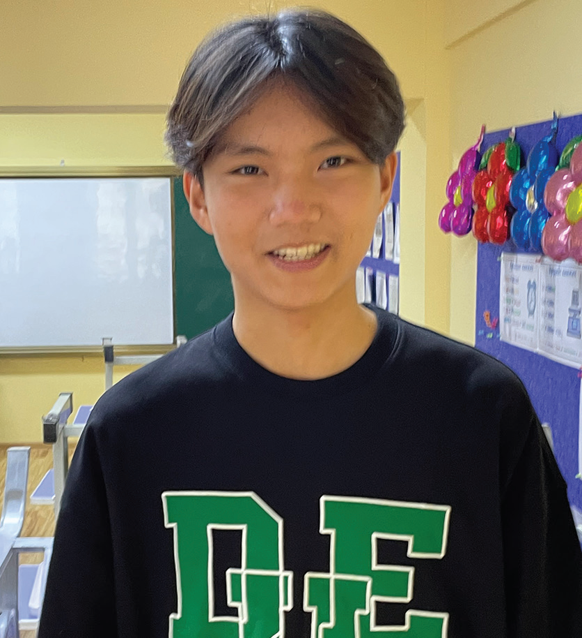
MONGOLIA
JANUARY 11
An Annoying
Girl
Elberel

Slide 7
Elberel [El-ber-el] grew annoyed during the Covid-19 lockdown. He studied at Tusgal School, the only Seventh-day Adventist school in Mongolia, and it was among the first to go to online classes. He didn’t enjoy sitting in front of the computer screen every day while children who went to public school were laughing and having fun.
He asked his mom if he could transfer to the public school.
Mom said she didn’t mind, but Dad said no. He was an Adventist pastor, and he was studying far away from home at Andrews University in the United States. Dad told Mom, “I’m not in Mongolia to help you. But we can’t risk our son’s future by sending him to public school. He might pick up bad habits.” So, Mom changed her mind and told Elberel that he had to stay at the Adventist school.
Elberel, however, didn’t give up. He asked Dad, “What about next year instead?”
Father didn’t relent.
Seeing it was useless to persist, Elberel didn’t say anything more.
But then the public school also went to online classes, and Elberel no longer saw other children laughing and having fun. The feeling of urgency to change schools passed.
After the lockdown ended and all schools reopened, Elberel began to think about public school again. The problem was a girl in his class. She seemed to like to argue with him and to insult him.

Slide 8
After two months, Elberel had had enough. He thought it would be easier to change schools than to put up with the girl. He called his dad, who was still studying at Andrews University.
“This girl keeps insulting me,” he said. “I want to transfer to public school.”
Father tried to talk Elberel out of his plan.
“You can’t transfer for something as little as that,” he said. “Even more kids will insult you in public school.”
But Elberel didn’t give up, and Dad relented. “I’ll let you transfer next school year,” he said.
Over the summer, Dad changed his mind, but Elberel remained steadfast in his determination to go to public school. He had studied at the Adventist school since second grade, and he was sure that it would be a healthy challenge for him to study somewhere else. He pleaded with Mom to allow him to transfer. Finally, his parents agreed, but Dad cautioned him to be careful.
“Ignore the kids who have bad habits,” he said.
Elberel promised that he would.
The first day at public school came as a shock to Elberel. Many of the boys in his class seemed to be vaping all the time.

Slide 9
They also insulted each other constantly. After school, they hung out and drank alcohol. Elberel didn’t want those kind of friends.
Moreover, Elberel had a problem with lunch. At the Adventist school, the children received a vegetarian lunch in the cafeteria every day, but the public school didn’t havea cafeteria. Elberel had to look for a place to buy food on the street.
As the days passed, Elberel realized that he had another problem. The classwork wasn’t challenging. He already knew everything that was being taught.
After a month, Elberel had had enough. He wished that he had listened to Dad, but he felt embarrassed to admit that he had been wrong. He prayed, “God, what should I do? Should I stay in the public school, where I am surrounded by bad influences and not learning anything new? Or should I return to the Adventist school and have to deal with that girl?”
The next day, Mom asked Elberel about his classes. Hearing that he wasn’t learning anything new, she asked, “Would you like to go back to the Adventist school?”
The question was like music to Elberel’s ears. He sensed God was answering his prayer. “Yes,” he said. “I want to go back.”
When Dad heard the news, he was happy.
“It isn’t too late,” he said. “You still can go back.”

Slide 10
Elberel has to wait a few more days before he can transfer back to Tusgal School. He can’t wait — and he has a plan on how to deal with the girl. “I plan to ignore her,” he said. “My dad said she wouldn’t be as much of a problem if I just ignored her.”
Tusgal School, located in Ulaanbaatar, Mongolia, received part of a previous Thirteenth Sabbath Offering to grow with new classrooms and a library. Thank you for your Thirteenth Sabbath Offering this quarter, which will help open a recreation center to introduce children to Jesus in Ulaanbaatar.

Slide 11
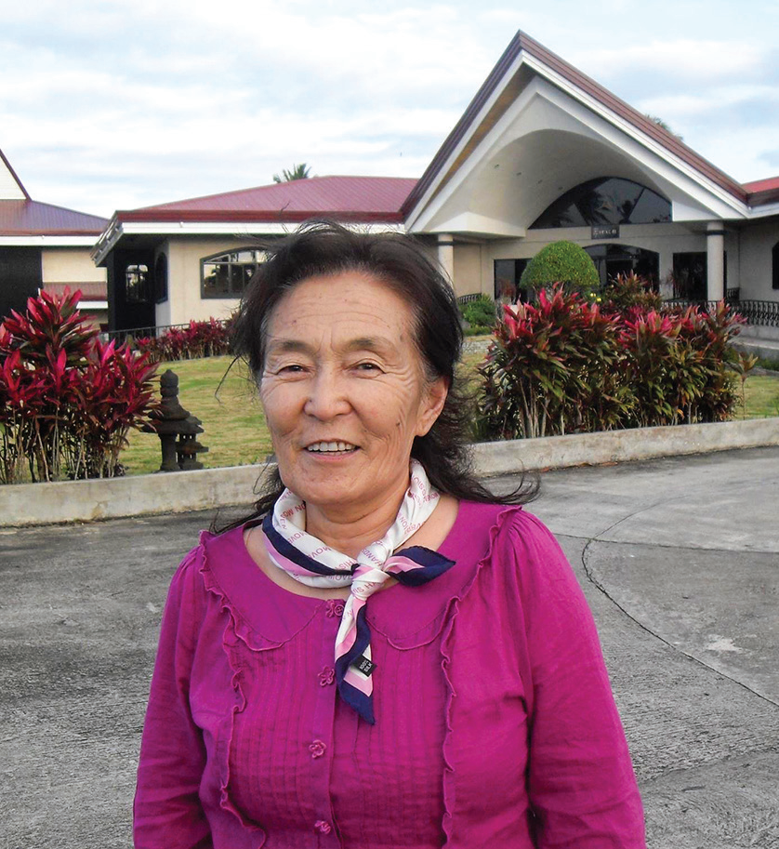
MONGOLIA
JANUARY 18
They’re Spies
Tserenjav Danzan

Slide 12
Mom was upset when her 22-year-old daughter, Debbie, started going to the Seventh-day Adventist church in Mongolia.
“Don’t go to the Americans’ meetings,” she said. “They’re spies.”
It was September 1992, and Mongolia was in a state of post-Communist transition.
Mom’s ire grew when Debbie decided to give her heart to Jesus in baptism in 1993. Debbie was the first Adventist convert in Mongolia after the Communist collapse.
“Americans are bad people,” Mom said.
“They’re spies, and they’re going to ruin our country by winning our hearts and then using us.”
Christianity was not the traditional religion in Mongolia, but Mom thought all religion was bad. She was a staunch atheist who had actively supported communism. Through her influence, many people became Party members. For her work, she had been awarded a special pin of Marx, Engels, and Lenin, and she wore it proudly.
There seemed to be no way that Mom would ever change her mind about God.
Debbie left Mongolia for two years to study at the Adventist International Institute of Advanced Studies (AIIAS) in the Philippines. When she returned home, she invited Mom to a small Bible study group that she had formed. At the time,

Slide 13
Mongolia’s fledging Adventist Church consisted mostly of young people, and the small Bible study group was aimed at
older people. The group’s first five members were Mom, two of her sisters, the mother of the first Mongolian pastor, and the mother of another church member.
Mom was very cautious about the small Bible study group, but she also was curious. She had seen a change in Debbie. Once proud, Debbie had become mild. Once bossy, she had become obedient to her mother and respectful of her sister.
“She has changed,” Mom thought. “What caused her to change?”
Then Debbie’s sister, who once had fiercely opposed Christianity, was herself baptized. Mom saw that she also had changed.
That was enough. In 2000, Mom decided to give her allegiance to the God of heaven. She was baptized and joined the Adventist Church at the age of 53. In fact, all five members of the small Bible study group ended up getting baptized.
Once an active recruiter for Lenin, Mother became an ardent witness for God. Once a seeker of members for the Party, she became a seeker of lost sheep for the Kingdom. Through her influence, many people gave their hearts to Jesus.
Mom was faithful until her death. She not only loved God, but she also loved to give to God. When she grew so weak that she could no longer go to church, a house church was organized in her home. She said that a worship service was not complete without the offering so, at her request, a collection box was brought to her bed so she could personally give an

Slide 14
offering.
Mom died of gallbladder cancer at the age of 74 in 2020. But she remained a witness even after her death.
A traditional Mongolian funeral usually involves many expensive rituals. But, at her request, she was buried at a simple Christian funeral. Her funeral was so different from the usual funerals that her relatives were amazed. They realized that something was different about Christianity.
“Wow, what a peaceful funeral,” said one. “I would like my funeral to be like that,” said another.
But Mom’s witness didn’t end there. She continues to preach from her tombstone in the cemetery. Her tombstone contains the promise of Isaiah 30:18, “Blessed are all those who wait for Him” (NKJV).
Shortly before she died, she told Debbie, “My hope is in Christ. I want to sleep until He comes.”
Now Mom is waiting on the Lord to raise her up on that glorious morning.
Thank you for your Thirteenth Sabbath Offering that will continue the missionary work of Mom — whose name is Tserenjav Danzan [ CZAR-en-jav DAN-za ] — and other faithful Seventh-day Adventists who are now resting in their graves in Mongolia. Part of this quarter’s offering on March 29 will help open a recreation center that will teach children and their parents about Jesus in Mongolia’s capital, Ulaanbaatar

Slide 15
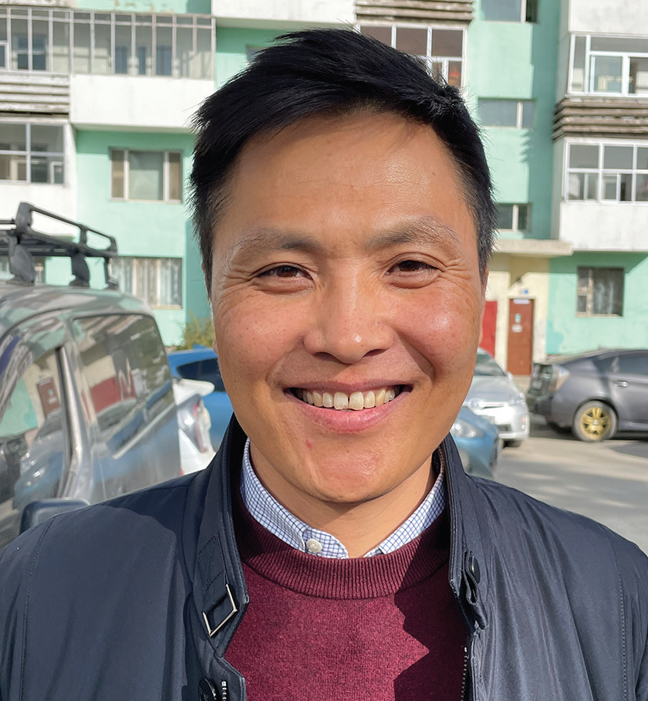
MONGOLIA
JANUARY 25
Seeking Answers
Part 1
Bold Batsukh

Slide 16
Editor’s note: This is the story of how Bold Batsukh, Mongolia’s first Seventh-day Adventist pastor, gave his heart to God in the early 1990s.
Whenever Bold had a question, he ran to his dad in Mongolia.
“I’m scared of the dark,” he said. “Why am I scared of the dark?”
“It’s all in your imagination,” Dad said.
Then the boy heard someone talking about God and the devil. He ran to Dad.
“Is there such a thing as the devil and God?” he asked.
“It’s all in your imagination,” Dad said.
Bold trusted his dad. He had seen Dad read many books, so he knew that he had stored up a lot of knowledge.
But he remained scared of the dark. He also wasn’t so sure that God didn’t exist. He didn’t understand why, but he felt that God must be alive somewhere in the universe.
Although Bold was young, he was very serious. He thought seriously about his future. When he thought about his future, he thought about death. Death scared him.

Slide 17
“Why do we die?” he wondered. “What happens after death? Is that it?”
One day, Dad fell ill. He was in and out of the hospital for treatment for several months. During one hospitalization, Bold noticed marks on Dad’s back from injections given by the nurses.
“Why do they have to give you so many shots?” he asked.
“I’m sick, so I have to get shots,” Dad said.
Bold felt sorry for his father.
Dad grew weaker and weaker. Finally, he couldn’t eat on his own, and his food was pureed like baby food and mixed with water. Someone fed him with a spoon, massaging his throat to help him swallow.
One afternoon, a friend ran up as Bold was playing outside his home.
“Your father’s dead! Your father’s dead!” the boy shouted.
Bold thought the boy was trying to make a joke, and he became indignant.
“Why do you have to joke like that?” he said.

Slide 18
“It’s the truth,” the boy said. “They’re looking for you.”
Bold ran home. An ambulance stood outside the building. No one would let him inside to see his father. Bold realized that Dad had died. He was only 45 years old. Bold was 13.
The boy cried and asked, “Why? Why?”
He heard no answer.
For the first time he spoke to the God whom his father had said didn’t exist.
He said, “I don’t see any reason for this happening.”
He heard no answer.
Bold had been close to Dad, and he couldn’t imagine life without him. He wondered, “If everyone is going to die, what’s the point of living?”
He heard no answer.
Bold had been scared of the dark. But now his fears grew as, in the darkness of the night, he had disturbing dreams

Slide 19
about his father. In his dreams, he asked his dad, “Why did you leave us?”
He heard no answer. How he wished that Dad was around to answer his questions.
Dad had been the family’s sole breadwinner. Without him, times were tough. Bold also felt resentment. He thought, “Dad might be alive if only he had taken better care of himself and gone to the hospital earlier.”
Mom also missed Dad terribly. She also had questions. She started to visit a teacher from a traditional Mongolian religion who claimed to have answers.
Bold noticed that Mom seemed to be happier after each visit. He was curious to find out if the teacher could answer his questions.
“Can I go and see him?” he asked.
“Let’s go together,” Mother replied.
Pray for the people of Mongolia who, like Bold, are looking for answers. Part of this quarter’s Thirteenth Sabbath Offering will help open a recreation center in Ulaanbaatar, Mongolia, for other children who have unanswered questions. Thank you for planning a generous offering on March 29.

Slide 20
MONGOLIA
FEBRUARY 1
Teacher’s Helper
Part 2
Bold Batsukh

Slide 21
Editor’s note: This is the story of how Bold Batsukh, Mongolia’s first Seventh-day Adventist pastor, gave his heart to God in the early 1990s. The story picks up with 13-year old Bold bitterly seeking answers to why his father died unexpectedly. He noticed that his mother was finding answers to her own questions from a teacher from a traditional Mongolian religion. Mother agreed to take the boy to meet the teacher.
People crowded outside the teacher’s house every day to ask for advice on how to solve their problems in Mongolia. People sat and waited to be called into the house.
When someone entered the house, the teacher asked, “What’s your problem?”
Then he listened for a long time. After that, he opened his sacred writings and chanted something from it in the Tibetan language.
No one understood what he said because no one spoke Tibetan, but people left the house looking happy.
The teacher couldn’t tell Bold why his father had died, but the boy was impressed by him and his sacred writings. Bold thought, “If I could help him, I could spend more time with him, and it would be a good way to get out of going to school!”
Back at home, he told Mom, “Maybe I’ll become a teacher, too. Could you ask your teacher if he would train me?”
Mother was reluctant, but she agreed to ask.

Slide 22
A few days later, she returned home from the teacher’s house with a big smile.
“The teacher was so happy when I told him your request,” she said. “He said that he has wanted to mentor a boy for a long time.”
Bold went to live with the teacher.
At 6 o’clock every morning, the teacher poked Bold with a wooden stick to wake him up. Then Bold sat for hours, learning the Tibetan language and memorizing texts from the sacred writings. He also had many chores, cooking for the teacher and cleaning his house.
Bold lived with the teacher for two years. He memorized all the texts that the teacher told him to memorize. He did everything that the teacher told him to do. When he was 15, the teacher took him to a monastery where he could be trained to become a teacher, too.
The head teacher at the monastery quizzed Bold. “What have you learned?” he asked. “Can you chant this text? Can you chant that text?”
Bold, the boy who once had asked many questions, was now able to give many answers from the sacred writings.
The head teacher was impressed.
“He is well trained,” he told Bold’s teacher.

Slide 23
“But we have just accepted some other boys, and we don’t have any space left. If you come back next year, we will take him first.”
It was a turning point. If Bold couldn’t train to become a teacher, he wanted to go back to regular school. He moved back home to Mom and his sister, who was his twin.
He hadn’t gone to school for two years, and he was far behind his former classmates. But he wanted to study with them again.
Mom spoke with the school principal, and he agreed to allow Bold to study with his old classmates for two months. If he could keep up with them, he could stay in the class.
Bold sat in the front row. Unlike before, when he was 13, he now was eager to learn.
To his surprise, the schoolwork was easy, and he quickly rose to the top of his class. His classmates couldn’t understand why he was doing so well. He had missed two years of school while they had been studying. Bold only realized later that two years of memorizing texts had cleared and disciplined his mind, enabling him to easily complete his school assignments.
After graduating from high school, Bold decided to learn English and become an English teacher. He already spoke Mongolian and Russian, and he thought that a third language wouldn’t be too difficult.

Slide 24
But after a few days of university classes, he was failing. English was much harder than he had expected. He wondered what to do. His twin sister had an idea. She had met some Americans, and they were teaching her English. “Come meet the Americans,” she said.
Bold wasn’t interested. Later, his sister showed him a New Testament in the Mongolian language.
“The Americans are Christians,” she said. “They’re talking about Christ.” Bold was alarmed. “Don’t go to them anymore,” he said. “We have our own traditional religion in Mongolia.”
But his sister wouldn’t listen. “These people are really nice,” she said.
Bold continued to struggle with his English classes. One day, as he labored over his homework, he remembered the Americans. He thought, “Maybe they could help me with my English.” He promised himself that if the Americans spoke about Christianity, he would show them that their religion was utterly unacceptable for Mongolians. He asked his sister if he could meet them.
The sister told the Americans about her brother. One of them replied, “Bring him to our house church this Sabbath.”
Pray for the people of Mongolia who, like Bold, are looking for answers. Part of this quarter’s Thirteenth Sabbath Offering will help open a children’s recreation center to share the gospel in Ulaanbaatar, Mongolia. Thank you for planning a generous offering on March 29.

Slide 25
MONGOLIA
February 8
Giving Bible a Chance - Part 3
Bold Batsukh

Slide 26
Editor’s note: This is the story of how Bold Batsukh, Mongolia’s first Seventh-day Adventist pastor, gave his heart to God in the early 1990s. The story picks up with Bold struggling to study English at a university in Mongolia. He asks his twin sister to introduce him to some Americans who are teaching her English and about God. He is determined to learn English from them and, if necessary, show them that Christianity has no place in Mongolia.
The Americans didn’t meet in a church but in the living room of their house.
They greeted Bold kindly when he came with his twin sister to their house church in Mongolia’s capital, Ulaanbaatar.
It was a most unusual experience for Bold. About 20 people were sitting in a circle on the floor, singing from songbooks. The words of the songs seemed so odd to Bold. He was confused and amused. He thought, “What do they mean by ‘hosanna’? Why are they singing about a ‘Lamb’?” He held a songbook over his face to hide his laughter.
After the song service, the Americans led a Sabbath School class. They spoke about King Nebuchadnezzar’s dream in Daniel 2.
Bold was fascinated and had many questions. But he kept silent.
Then one of the Americans preached a short sermon. None of the words made sense to Bold. The preacher talked about an image in the book of Revelation that Bold didn’t understand. The preacher spoke about Jesus coming back, and Bold wondered, “Where did He go, and why does He need to come back?”

Slide 27
After lunch, the house-church group went to an orphanage to do crafts with children.
When Bold returned home that night, he felt good. It had been a good day, and he had enjoyed helping the children. “I’ll have to give the Americans a chance,” he thought. “Maybe I should listen to their ideas.”
He eagerly waited for the next Sabbath.
After the Sabbath sermon, he sat down with the Americans and listened. What he heard was very different from what he had been taught. The Americans opened a Bible to Genesis and shared the Creation story. Bold was very interested. He had studied with a teacher from a traditional Mongolian religion for two years as a boy, but his teacher hadn’t been able to explain the origin of life. The teacher had told a legend about dust coming together and forming the Earth. But the legend didn’t explain the origins of water, air, and living things. To those questions, the teacher had no answers. But the Bible had clear answers about all of those things.
Bold had many questions, and he began to ask them. The American missionaries answered his questions from the Bible. When they learned that he knew Russian, they gave him a Russian Bible. At the time, only the New Testament was available in the Mongolian language so, with the Russian Bible, Bold had access to the whole Word of God.
On his third Sabbath at the church, a missionary said, “Why don’t you teach Old Testament stories with children’s felts?”
Bold was surprised. He didn’t feel qualified to teach the Bible to anyone.

Slide 28
The missionary encouraged him to try. “Just go for it,” he said.
The challenge intrigued Bold, so he agreed.
That week, he carefully read the Russian Old Testament and took notes in Mongolian. On Friday, he went to the missionaries’ house and picked out the felts that he wanted to use the next day. On Sabbath, he told Old Testament stories in Mongolian to a rapt audience at the house church.
At home, Bold kept reading the Bible, and he found answers to all of his questions. He learned that God and the devil are real. He read in Genesis 3 that the devil, disguised as a snake, brought sin and death into the world. He also read in Genesis 3 that God put forth a plan to save humanity. As a result, he learned, death is not the end, and people who believe in Jesus have eternal life. In John 3:16, he read, “For God so loved the world that He gave His only begotten Son, that whoever believes in Him should not perish but have everlasting life” (NKJV).
He gave his heart to Jesus.
Today, Bold is a leader of the Adventist Church in Mongolia. He holds the distinctions of being not only the first Mongolian Adventist pastor but also the first ordained Mongolian pastor. He also speaks fluent English.
“I learned in the Bible about a loving God who created us and, when we sinned, came to rescue us. That was more appealing than anything that I had been taught before. I gave the Bible a chance, and that’s why I’m an Adventist today.”

Slide 29
He said that even though he suffered after his father died, he found God as a result.
“Even though it was a tragedy in my life, it ended up being so good,” he said. “By coming to Christ, I found answers to all my questions. God was with me all that time.”
Pray for the people of Mongolia who, like Bold, are looking for answers. Part of this quarter’s Thirteenth Sabbath Offering will help open a children’s recreation center to share the gospel in Ulaanbaatar, Mongolia. Thank you for planning a generous offering on March 29.

Slide 30
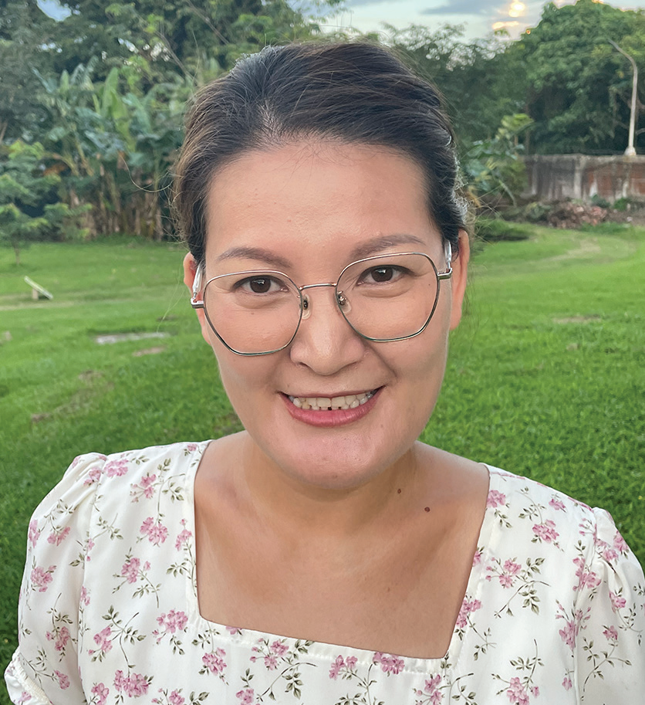
MONGOLIA
February 15
An Impossible Dream
Eegii

Slide 31
Editor’s note: Eegii was among the first teachers who taught at Mongolia’s only Seventh-day Adventist school when it opened in 2009. She had just graduated from a Mongolian university and had no experience teaching at an Adventist school. She and the other teachers led the first year’s group of 13 children with prayer and passion. Today, Tusgal School has 250 students. This is Eegii’s story.
Eegii taught at the Seventh-day Adventist school in Mongolia, but she wished for an Adventist education of her own. She wondered, “How can I show God’s love better?”
Years passed, and Eegii attended seminars about Adventist education in Mongolia. But the seminars were short, and Eegii longed for more. She prayed. She added the Adventist International Institute of Advanced Studies (AIIAS) to her prayers when she learned it offered a master’s degree in education in the Philippines. But her dream seemed impossible. She prayed for 10 years.
Then the Northern Asia-Pacific Division, whose territory includes Mongolia, offered Eegii a scholarship to study at AIIAS. Eegii was overjoyed! God had answered her prayers. But she didn’t know if she could accept the scholarship, which only covered her education. She would still need to pay for housing, utilities, and food. She also had a husband and two school-age sons whom she couldn’t leave behind. They would need tickets to fly to the Philippines, and her boys would need money to study at an Adventist school there.
Eegii prayed and prayed. Her dream seemed impossible. Then she and her husband decided to step out in faith. They sold their car and furniture. When they added the money to their family savings, however, they still didn’t have enough.

Slide 32
That night, Eegii went to bed worried.
As she slept, she had a dream. She was pacing back and forth in a small room without any doors or windows. She was trapped. Then God gave her a piece of paper and said, “I will help you.” A moment later, she was sitting in the back of a pickup, traveling down a road. The pickup stopped at a railroad crossing, a train passed, and the pickup drove on. Eegii woke up with all of her worries gone. God’s words rang in her ears, “I’ll help you.” Eegii was no longer worried, but she still didn’t know what to do. Her dream seemed impossible.
A few days later, as Eegii walked to church on Sabbath, an unusual sight caught her eye. A large tree was growing out of a row of private parking garages. The roots of the tree were sunk deep into the concrete roof of the garages. Eegii thought, “It’s impossible for a tree to grow on a concrete roof.”
Immediately, the angel’s words to Mary sprang into her mind, “For with God nothing will be impossible” (Luke 1:37, NKJV).
She thought, “God is showing me that everything is possible for Him!”
Eegii took a photo of the tree on her cellphone and happily showed it to her friends at church. She had no doubt that she and her family would go to the Philippines.
That’s exactly what happened. Over the next few weeks, Eegii got plane tickets and left Mongolia. God even blessed

Slide 33
her en route to the Philippines. She had a six-hour layover to change planes in Turkey, and she got to spend time with two
relatives living there.
When she arrived at AIIAS, she was alone, just like she had been alone in the back of the pickup in her dream. But she believed that God would help her. She believed a tree could grow out of a concrete roof. She prayed and waited. Two months later, her husband sold the last of their possessions, and he and their two sons had the funds to join her.
Today, the family is living at AIIAS as Eegii studies for her master’s in education. She couldn’t be happier. Her impossible dream is being fulfilled. She is obtaining an Adventist education, and she can’t wait to share God’s love in new ways back home.
“We need to look at God rather than at our problems, and we need to move forward in faith,” she said.
“When the Israelites fled Egypt, they stopped at the Red Sea in fear,” she said. “But then when they stepped forward in faith, they saw God miraculously part the water. So, walk forward with God in faith, prayer, and thanksgiving.”
Pray for Eegii and the other teachers at Tusgal School, the only Seventh-day Adventist school in Mongolia. Part of a previous Thirteenth Sabbath Offering helped the school expand with new classrooms and a library. Thank you for planning a generous offering on March 29 for this quarter’s Thirteenth Sabbath projects in Mongolia and elsewhere in the Northern Asia-Pacific Division.

Slide 34
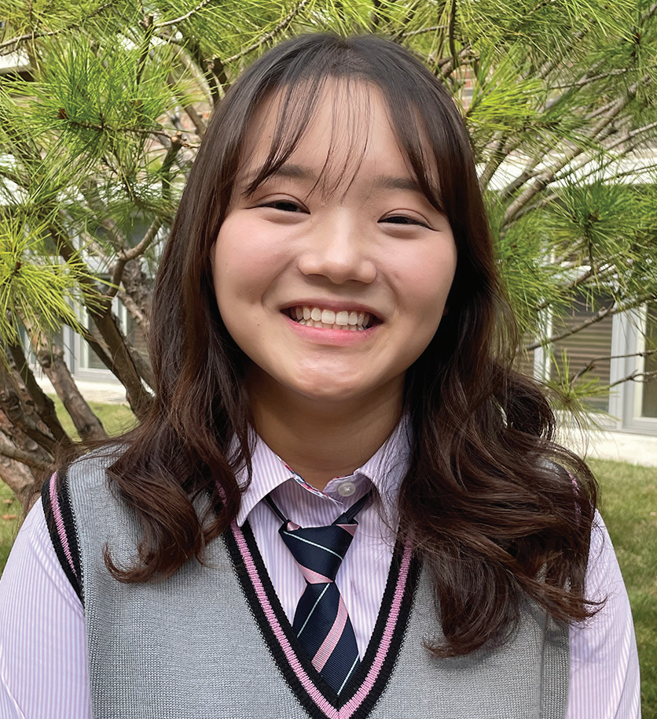
SOUTH KOREA
February 22
Book Worth Reading
Yu Jin

Slide 35
When Yu Jin [YOU-jeen] was 9 years old, her mom gave her a book to read.
“Since you read a lot of books, you should read this book, too,” she said. “It’s in Korean and English. Study it. Read it. This is a good book.”
It was the small book Steps to Christ by Ellen White.
Up to that point, Yu Jin had only read books in Korean. But Mom wanted her to learn English.
An obedient child, Yu Jin immediately began to read the book.
She read it every day on the bus as she traveled to and from school in South Korea. She read during lunch break at school.
The English text was too hard to read, so she skipped it and finished the Korean part of the book in a week.
She didn’t understand everything that she read, but she felt a strong conviction that she needed to be baptized.
She went to Mom.
“I want to be baptized,” she said.

Slide 36
Mom smiled.
“When you grow up, you can be baptized,” she said.
Korean children often start thinking about baptism when they are about 13 years old. But Yu Jin was 9, and 13 was four long years away. She wasn’t happy about having to wait. But she was an obedient child.
“OK, fine,” she said.
She didn’t speak about baptism again.
As time passed, she kept attending church every Sabbath as she had in the past. But she went because she wanted to participate in Pathfinders and other fun activities, not because she desired a close relationship with God.
When she turned 13, she was baptized with the rest of her friends. But she didn’t have the same conviction to be baptized as when she was 9.
As a teen, she spent more and more time with non-Christian friends, and her love for God gradually dimmed. She ate like her friends and sometimes skipped church on Sabbath. She was tired on Sabbath morning and didn’t want to make the effort to go to church.
Doubts even crept into her mind about the existence of God.

Slide 37
Then one summer, when she was 16, she volunteered to help with an evangelism program. Her job was to invite other young people to come to the church meetings by handing out flyers.
No young people came to the first meeting as a result of her invitations, and she felt like a failure.
A missionary from the meetings saw her disappointment and prayed with her.
To Yu Jin’s amazement, several young people whom she had invited showed up at the next meeting.
A flicker of faith flashed in her heart.
Then heavy rain threatened to disrupt a meeting. She prayed, and the rain stopped. The meeting went ahead as planned.
Yu Jin was a new person when she returned to her Adventist high school in the fall. She eagerly attended a student-led prayer group, called “Kneelers,” that met every Friday evening after worship services. She got a new copy of Steps to Christ. But this time, she didn’t finish the book in a week. She read it with a group of other students at the rate of about a chapter a week. For her, it was like reading the book for the first time.
Yu Jin said she is glad that she read Steps to Christ when she was 9.
“When I read it for the first time, my heart was stirred deeply to follow Jesus and to be baptized,” she said.

Slide 38
She is even more glad that she read it again. She said the book cannot be read too many times.
“Surely the Lord is coming again,” she said.
Yu Jin goes to Hankook Sahmyook Academy, which will receive part of this quarter’s Thirteenth Sabbath Offering to open a gym and missionary training center, in Seoul, South Korea. Thank you for planning a generous offering on March 29.

Slide 39
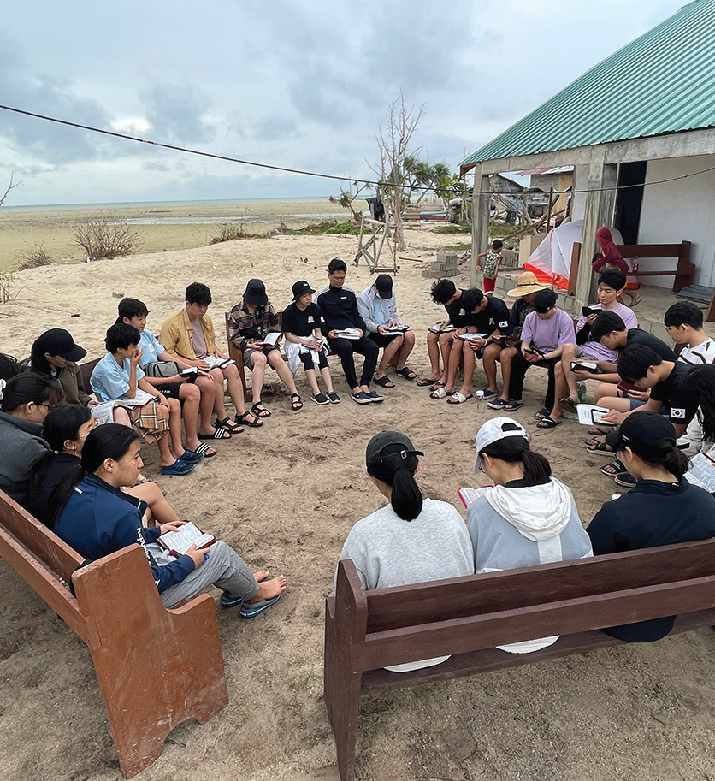
SOUTH KOREA
March 1
Praying in the Storm
Academy Missionary Movement
South Korea

Slide 40
One of this quarter’s Thirteenth Sabbath projects is to train children and teens to be missionaries in South Korea. The project envisages the opening of a missionary training center at Hankook Sahmyook Academy, which includes a middle school and a high school, in South Korea’s capital, Seoul.
Missionary training programs are a staple of Adventist life in South Korea. This week’s story is about a group of 19 Korean teens who joined one such program called Academy Missionary Movement.
A fierce thunderstorm broke out on the first night that 19 South Korean teenage missionaries spent on a Philippine island.
The teens, ages 14 to 17, had not signed up for a thunderstorm when they joined a one-year mission training program called Academy Missionary Movement. Part of the program required them to participate in an international mission trip, and they had come to the remote island to assist with evangelistic meetings under the guidance of a South Korean pastor, who would preach.
But the storm that greeted them on their first night threatened to spoil their plans.
Eleven boys were sleeping in tents set up on the concrete floor of a partially constructed church building located on a sandy beach. Eight girls were sleeping in a thatched house nearby.
The night was pitch-black except for sharp flashes of lightning. Rain poured down, and the wind howled. The church building had no doors or windows, and the tents sheltering the boys trembled violently.

Slide 41
Then the South Korean pastor began to wake up the boys.
“The situation is serious,” he told two boys in one tent. “We need to get up and pray.”
He asked the boys to rouse the boys in the next tent and tell them to pass on the word until everyone had assembled to pray in the thatched house.
Meanwhile, the mission program director woke up the girls in the thatched house with similar instructions.
Before long, the teens had gathered in the thatched house. The building’s walls shook against the blast of the storm.
None of the teens or adults had seen such a bad rainstorm.
It was 4 a.m.
Everyone knelt down and prayed for God to stop the storm. For two hours, the missionaries prayed as the wind howled, the lightning flashed, and the rain fell. The pastor asked God to forgive the sins of everyone in the group. The teens sang worship songs. Each person took time for personal prayer. The pastor also gave a short sermon about God being a refuge in the storm.
By 6 a.m., the storm started to die down.

Slide 42
The pastor told the teens to go to bed. Seeing that it was their first night on the island, he didn’t want them to be too exhausted on their first full day.
The sun was shining brightly in the blue sky when everyone woke up two hours later.
The storm set the scene for the rest of the week. The mission trip became a season of prayer. Whenever it rained, everyone knelt and prayed. Whenever a teen faced a challenge, like inviting people to attend the evening meetings, everyone knelt and prayed. The teens realized that they were fighting for the salvation of souls. Sometimes they knelt in pairs and prayed for someone whom they had just met in a nearby village.
The mission trip offered some surprises for the teens, who were accustomed to conveniences like running water and heated toilet seats back home in South Korea. On the island, they used shovels to dig their own toilets and took outdoor baths with buckets or in the ocean. No one complained.
Every evening, the teens gathered near the unfinished church building to read the Bible, discuss the day, and thank God for life, food, and good weather.
At the end of the trip, seven people were baptized in the ocean. They had taken Bible studies with local church members and made the decision to get baptized during the evangelistic meetings.
The teens rejoiced that seven people had given their hearts to Jesus. They returned to South Korea, expressing an eagerness to be lifelong missionaries for Jesus.

Slide 43
Part of this quarter’s Thirteenth Sabbath Offering will train students to become missionaries at Hankook Sahmyook Academy in Seoul, South Korea. Your offering will help open a missionary training center and gym at the academy. Thank you for planning a generous offering on March 29

Slide 44
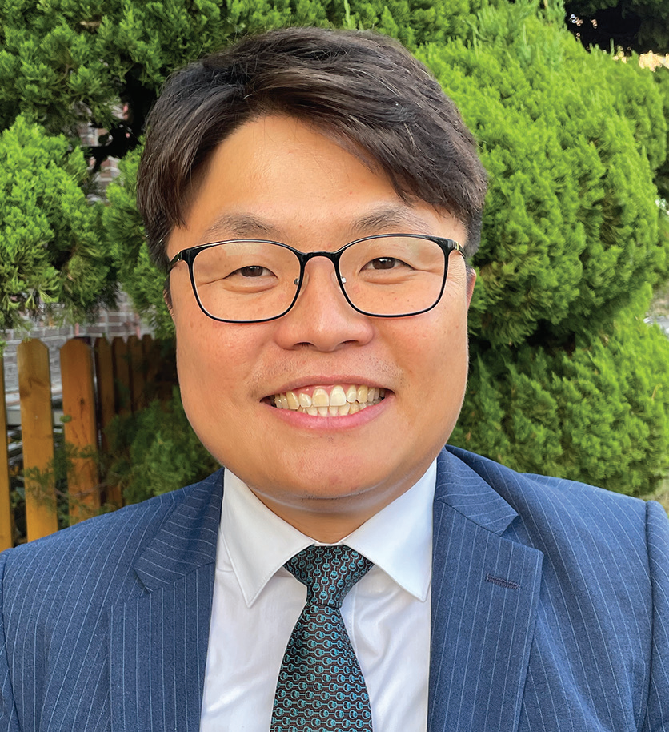
SOUTH KOREA
March 8
“I Can’t Live Like This!”
Jin-seok

Slide 45
Jin-seok [GIN-see-ok] was 2 when his father died. He has no memories of his father.
Dad was a Seventh-day Adventist pastor in South Korea, and Mom singlehandedly raised Jin-seok and his brother. Her faith was Jinseok’s faith — until he grew into a teenager.
Then Jin-seok began to think for himself, and he refused to believe in God.
He thought, “If God exists, why did He allow Dad to die?”
The boy told God, “If You exist, You can kill me, too. I can’t live like this!”
When he was 15, Jin-seok decided that he had had enough.
During family worship, he abruptly stood up and ripped his Bible in two.
“Mom, don’t tell me to believe in God,” he said.
With that, he dropped out of school and moved out of the house.
For the next 10 years, Jin-seok smoked, drank, and mingled with worldly friends. He didn’t have a Bible, and he hated Christians, especially Adventists.

Slide 46
One day, he inadvertently ended up on the campus of an Adventist university in South Korea’s capital, Seoul. He was accompanying a friend who had business at Sahmyook University.
As he waited for his friend, he wanted to smoke, but smoking was prohibited at the university. So, he looked for a place where he could smoke without getting caught.
Finding a remote park-like area with trees and bushes, he sat down on a bench and lit up a cigarette.
As he smoked, he looked around and saw a Bible verse engraved on a stone. He suddenly realized that he was in the university’s prayer garden.
A flood of emotions filled his heart. He had no memories of his father, but he remembered that Dad had studied at that same university to become a pastor. Dad had probably prayed in the same prayer garden.
Then Jin-seok’s thoughts turned to his mother. He remembered hearing that Mom was very ill. Several people had told him that she would die soon.
Grief filled his heart. Dad had died when he was 2, and now Mom was dying when he was 25.
“I can’t live like this!” he exclaimed.
Now Jin-seok began to feel sorry for his mother. He thought, “Mom lost her husband. She has two sons, but she lost

Slide 47
me, too. I’m breaking her heart, and now she’s going to die.”
Tears poured down his cheeks.
In the university prayer garden, with a lit cigarette between his fingers, he spoke to God for the first time in years.
“God, if you exist, please help me,” he said. “Please help Mom. If You do, I’ll surrender my heart to you. I’ll give my life to you.”
Not long after that prayer, Mom recovered, and Jin-seok kept his promise. He became a pastor just like his father. He graduated from Sahmyook University just like his father.
Mom was thrilled!
But the story didn’t end there. Jin-seok got married, had a daughter, and is now helping raise four boys from single-mother homes. Remembering how he grew up without a dad, he began caring for the four boys with the support of the members of the church that he pastors in rural South Korea.
The boys, who are now teens, are living very different lives than Jin-seok did at their age because they see Jin-seok’s love and know that they have a Father in heaven who loves them even more. All four boys have given their hearts to Jesus in baptism.

Slide 48
Jin-seok hopes to send them to an Adventist high school in Seoul one day. He hopes that they will become missionaries.
Gone are the days when Jin-seok exclaimed, “I can’t live like this!” He has found that life with God is worth living, and he looks forward to meeting his father at Jesus’ soon coming.
Part of this quarter’s Thirteenth Sabbath Offering will go to Hankook Sahmyook Academy, where Jin-seok hopes to send his adopted sons to study, in Seoul, South Korea. Your offering will support the opening of a missionary training center and gym at the school. Thank you for planning a generous offering on March 29.

Slide 49
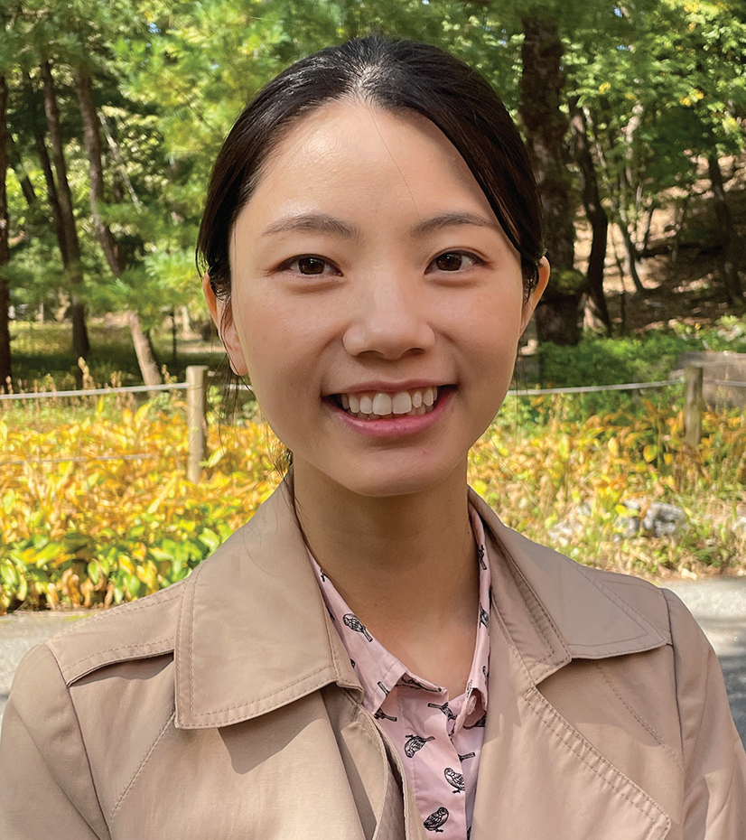
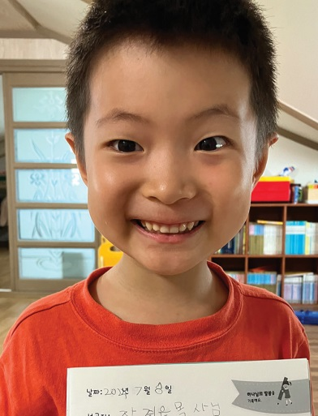
SOUTH KOREA
March 15
Storing God’s Word
Olivia & David

Slide 50
This quarter, the Northern Asia-Pacific Division is placing an emphasis on training children to be missionaries through a Thirteenth Sabbath project that envisages the opening of a missionary training center at Hankook Sahmyook Academy in South Korea. But a South Korean mother says the training of children to be missionaries begins at home. She started with her son when he was just beginning to talk. This is the story of how Olivia plants the Word of God in her children’s hearts.
When David was 18 months old, his mother began to read four small books to him. Each book had a Bible passage with simple pictures. The first book had Psalm 1; the second, Matthew 5:3–12, the third, John 14:1–4, and the fourth, 1 Corinthians 13.
Mom read the books when David got up in the morning, She read when he went to bed at night. She also read during the day.
In only a month, little David, who was just learning to talk, had memorized all four books. Today, David is 7, and he has memorized between 350–400 Bible verses.
How was it possible?
David’s mother, whose name is Olivia Kim, was inspired by her own mother-in-law, who taught four adopted children to read and write by memorizing Bible verses. Olivia was deeply touched when she saw firsthand how the Bible transformed little hearts. When she became a mother, she wanted to do the same for her son. So, she began to read the four small books, which her mother-in-law made.

Slide 51
As she read, David’s eyes followed the pictures and his ears followed her voice. He didn’t say anything. He couldn’t read. But after a month, he had memorized the books. When Mom showed a picture, he recognized it and repeated the words on the page. Mom was amazed because this was about the same time that he was beginning to talk and make meaningful words and sentences.
Then Mom made books with Psalm 121, Leviticus 6:4–9, the three angels’ messages in Revelation 14, the Ten Commandments in Exodus 20, and the blessings and curses of Deuteronomy 28. She read to David for 20–30 minutes in the morning and for 20–30 minutes at night. She also read during the day. He memorized those books as well.
David and Mom rely on Bible verses in every-day life. David goes to a kindergarten where the teacher sometimes shows cartoons during breaktime. Popular Korean cartoons feature ghosts that look cute and harmless, but the storylines can be serious. After watching one of those cartoons, David got scared one night and ran to Mom’s bedroom.
“Mommy, I’m scared,” he said.
“Why are you scared?” Mom asked.
“I remember a cartoon that I watched today,” he said.
“Don’t be scared because God is with you,” Mom said. “This house is under God’s protection. Angels are watching over us. Let’s recite Psalm 121 together.”

Slide 52
Mom and son recited Psalm 121, which begins with the words, “I will lift up my eyes to the hills — from whence comes my help? My help comes from the Lord, who made heaven and earth” (NKJV).
Another time, David was being mischievous. He was 4 and overly excited after evening worship. He didn’t want to wash his face, brush his teeth, or pick up his toys. Mom was busy with housework, washing dishes, doing laundry, and caring for a 6-month-old baby daughter. It was an hour past his usual 7 p.m. bedtime. Mom grew frustrated as David kept playing and running around the house. Finally, she lost her patience and exclaimed, “Why are you acting like this? Do as I say! Do your chores!”
The boy froze. Mom hardly ever talked like that. He looked up at Mom, and Mom looked down at him. Mom felt sorry that she had raised her voice. As the two stood still, 1 Corinthians 13 sprang to Mom’s mind, and she began to recite it, silently, “Though I speak with the tongues of men and of angels, but have not love, I have become sounding brass or a clanging cymbal.” Then she looked at David and saw in his eyes that he also was reciting 1 Corinthians 13 in his mind. She smiled. David smiled. The two hugged each other. “I’m sorry that I raised my voice,” Mom said. David smiled and clung to her more tightly. Then he changed into his pajamas, brushed his teeth, and went to bed.
Today, David loves memorizing the Bible. His sister, Abigail, is 3 and is memorizing the first four books that he memorized. Mother has memorized everything that they memorize. She has found that the memorization process happens automatically for her while she is teaching her children.
“I earnestly hope that the verses we are memorizing today will be boldly proclaimed from my children’s lips one day as they become missionaries for the kingdom of God,” she said.

Slide 53
Pray for Olivia and every parent seeking to plant the Word of God in children’s hearts. Pray that these homes produce a bountiful crop of missionaries. Pray also for the missionary training center that will open with the help of this quarter’s Thirteenth Sabbath Offering at Hankook Sahmyook Academy in South Korea. Thank you for planning a generous offering on June 29.

Slide 54
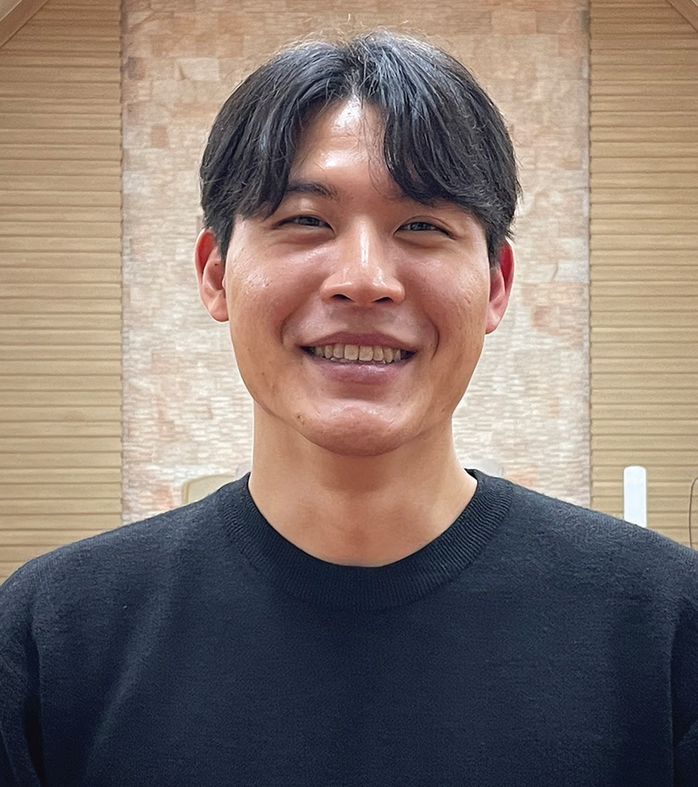
SOUTH KOREA
March 22
The Annoyed Missionary
Philip

Slide 55
One of this quarter’s Thirteenth Sabbath projects aims to train young people to be missionaries in South Korea. The project envisages the opening of a missionary training center at Hankook Sahmyook Academy in Seoul. Missionary training programs are a staple of Adventist life in South Korea. This week’s story is about Philip, who joined one such program called Compass Missionary Training Program, which included three months as a missionary in the U.S. city of Atlanta.
Philip stepped off the airplane in Atlanta, ready to work in urban mission for three months. The 23-year-old South Korean missionary had a busy schedule ahead of him. During the week, he was to work with refugees, including mentoring refugee children with their schoolwork. On Sabbaths, he was to teach children’s Sabbath School and do other activities.
But he quickly ran into a problem: his roommate.
Philip arrived with a group of other South Koreans to serve as short-term missionaries. They were divided into pairs, and Philip was teamed up with Samuel, who was 20. Philip and Samuel moved into a rented house.
It didn’t take long for Philip to grow annoyed with his roommate. Samuel thought for a very long time, every time, before he spoke. Then, when he spoke, he spoke very slowly. Philip thought crossly, “Why can’t you think and talk more quickly?”
His discontent grew. The two young men ate simple meals, usually salad and other food left over from the Sabbath fellowship meal at a local Korean church. One day, Samuel decided to reheat a leftover Korean rice cake in the oven.

Slide 56
But the rice cake burned and stuck to the baking dish. Philip was annoyed because he had cautioned Samuel to be careful about heating up the rice cake. Then Samuel tried to reheat another rice cake, this time in a frying pan on the stovetop. But the rice cake burned and stuck to the pan. Philip’s irritation grew but he didn’t say anything.
Samuel also didn’t say anything until about a month into their stay in the United States. One day, he suggested praying together before going out to work with the refugees. The two had never prayed together.
Samuel’s prayer shocked Philip. Speaking very slowly as he always did, he prayed, “Please, Lord, help me not to hate Philip.”
Philip understood that Samuel was praying for them to get along. But he gained no joy from the prayer. He was annoyed. His irritation grew when Samuel repeated the same prayer the next day and then the next. “Please, Lord,” Samuel prayed, “help me not to hate Philip.”
Philip and Samuel spoke less and less to each other. Finally, they stopped talking all together.
The conflict came to a head a month before their time ended in the United States. Philip was driving a car, and Samuel was seated beside him. Both were exhausted, and both fell asleep. Abruptly, they woke up and saw that they were about to smash into the vehicle in front of them. Philip swerved to the left, and they crossed into the oncoming lane. They collided head-on with a big truck.

Slide 57
The car was wrecked, but Philip and Samuel escaped uninjured. The truck driver also wasn’t hurt, and the truck suffered only a small dent on the front bumper.
At home, Philip and Samuel embraced and fell on their knees to thank God for life.
Philip felt ashamed. He had come to the United States to share God with others but had instead been focusing on himself. This was the root of his conflict with Samuel. But now the conflict seemed so small and unimportant. Philip thought, “We should have been hugging and praying together this whole time so God could have blessed us as missionaries.”
Samuel suggested that they tell the Korean owners of their rented house, a married, non-Christian couple, about the crash.
A short time later, Philip and Samuel were telling the couple about their two-month personal conflict and the crash. They shared everything from the beginning to the end. It wasn’t a biblical discourse on salvation. It was their story of how God had been with them in the United States. For Philip, it was the first time that he had ever shared what God meant to him. He feared that the couple might react negatively. But they only expressed worry for his and Samuel’s health.
The mission trip to the United States marked a turning point for Philip. When he returned to South Korea, he was asked to write a testimony about his experience.
He wrote a list of his accomplishments, including resolving the conflict with Samuel. But when he read over the list,

Slide 58
he felt ashamed to see it filled with “I did this” and “I did that.” Not once was Jesus mentioned.
He wrote a second draft that he didn’t like any better. He realized that he hadn’t accomplished anything. His testimony was that God had used him to accomplish something. He whittled down his testimony in one sentence: “God used me, a weak and proud person, but He used me.”
Pray for the Korean young people who are serving as missionaries around the world. Pray for Hankook Sahmyook Academy, whose students will study at a missionary training center that opens with the help of your Thirteenth Sabbath Offering on June 29. Thank you for planning a generous offering for this project in Seoul, South Korea.

Slide 59
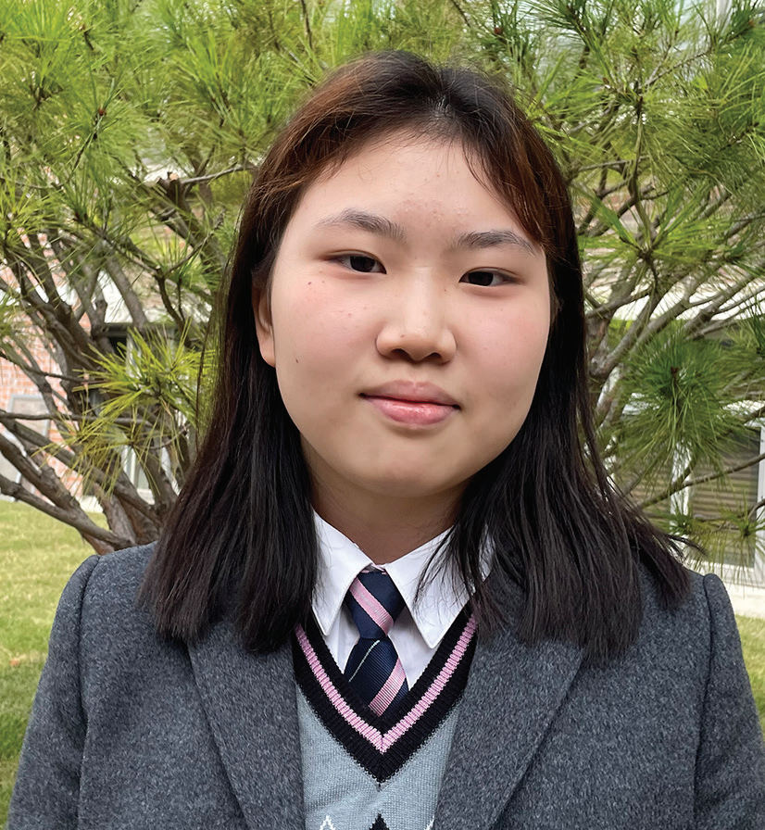
13th Sabbath
SOUTH KOREA
March 29
Meeting God At School
Hyun-hee

Slide 60
Ever since she was a small girl, Hyunhee [HYOUNG-hee] felt like she had to go to church on Sabbath. Her father was the pastor of a small church in South Korea, and she couldn’t stay at home or do whatever she wanted.
As time passed, Hyun-hee grew tired of church and being a pastor’s daughter. She couldn’t understand why Dad answered the phone late at night and even worked on weekends and holidays. Feelings of bitterness and resentment filled her heart when a long-awaited family vacation was canceled because Dad, as the church pastor, couldn’t miss a funeral. She began to question her faith.
It was then that the 16-year-old girl arrived at a Seventh-day Adventist high school in South Korea’s capital, Seoul. For the first time, she was far from home, living in a dormitory. For the first time, she was studying at an Adventist school. There was no Adventist school in the town where her parents lived.
At first, the Adventist school seemed to be the same as public school with the exception that the teachers believed in God and the students gathered regularly for worship.
At morning worship, however, Hyun-hee heard an announcement about something called “Kneelers.” She was curious to know more and, because she was shy, asked another girl to go with her to “Kneelers.”
“Kneelers” turned out to be a student led prayer meeting in the conference room of the Adventist middle school located on the same campus as the high school. The conference room had pews like a church.

Slide 61
About 30 teens, half girls and half boys, were sitting in the pews and singing when Hyun-hee and her friend arrived. A boy was playing a piano.
Hyun-hee’s mouth dropped open. She usually didn’t sing during song service in her home church. She was the only teen there. But these teens were singing loudly. She had never seen such enthusiasm. Tears filled her eyes. She was homesick, and the music was like balm to her soul. In an instant, all her loneliness disappeared, and she felt at peace.
After the last song, the young people knelt and prayed silently for a moment. Then several teens took turns speaking about what God was doing in their lives.
Hyun-hee’s mouth dropped open again. She had never heard people her age talk about God in such a personal way. She thought, “They’re young, but they have faith and believe in God. They love God despite the struggles in their lives.”
After that, the teens divided into small groups for prayer. At her home church, Hyun-hee’s mind usually drifted off to other things during a prayer. But these teens clearly enjoyed praying, and they spoke to God with passion and earnestness. Her mouth dropped open again.
As the hourlong meeting ended with more songs, Hyun-hee thought with astonishment, “These young people are more sincere and devoted to God than me.” She couldn’t wait for the next meeting. She thought, “This is living faith. I have found it. This is how Christians really live.”

Slide 62
As she kept going to the weekly “Kneelers” meeting, she discovered joy in worshiping God. She began to spend hours
with Him, singing, listening to worship songs, and praying. She sensed God’s presence for the first time. She wept as she
reflected on Jesus’ incredible love and sacrifice on the cross.
As time passed, she saw that teens and teachers alike prayed earnestly and praised God even amid problems. She got involved in various spiritual programs at the school and joined a student-led Bible study group.
As she wrapped up her first year at the high school, Hyun-hee found great joy in the worship programs. She eagerly participated in the weekly prayer meeting, the Bible study group, and other spiritual activities. Church was no longer tiring, and she looked forward to going every Sabbath.
Her favorite Bible passage is Philippians 4:4–7, which says, “Rejoice in the Lord always. Again I will say, rejoice! Let your gentleness be known to all men. The Lord is at hand. Be anxious for nothing, but in everything by prayer and supplication, with thanksgiving, let your requests be made known to God; and the peace of God, which surpasses all understanding, will guard your hearts and minds through Christ Jesus” (NKJV).
She believes that God sent her to the Adventist high school to teach her to live according to those verses.
“God saw my wavering faith and helped me to understand His purpose,” she said. “I met God at the school, and I have learned to thank Him for everything.”

Slide 63
Hyun-hee goes to Hankook Sahmyook Academy, which will receive part of today’s Thirteenth Sabbath Offering to open a missionary training center and gym in Seoul, South Korea. Today’s offering also will support four other projects in the Northern Asia-Pacific Division, including a shelter for single mothers in Ansan, South Korea; after-school centers at 14 schools in Japan; a children’s recreation center in Ulaanbaatar, Mongolia; and the establishment of an Adventist elementary school system in Taiwan. Thank you for your generous offering.

Slide 64
